Slide 1
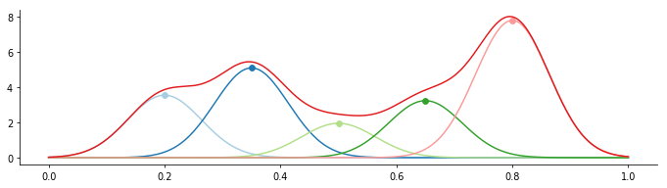
Learning RBF from the Germans
Stefano De Marchi
Department of Medicine, Padova Neuroscience Center
University of Padova

Slide 2
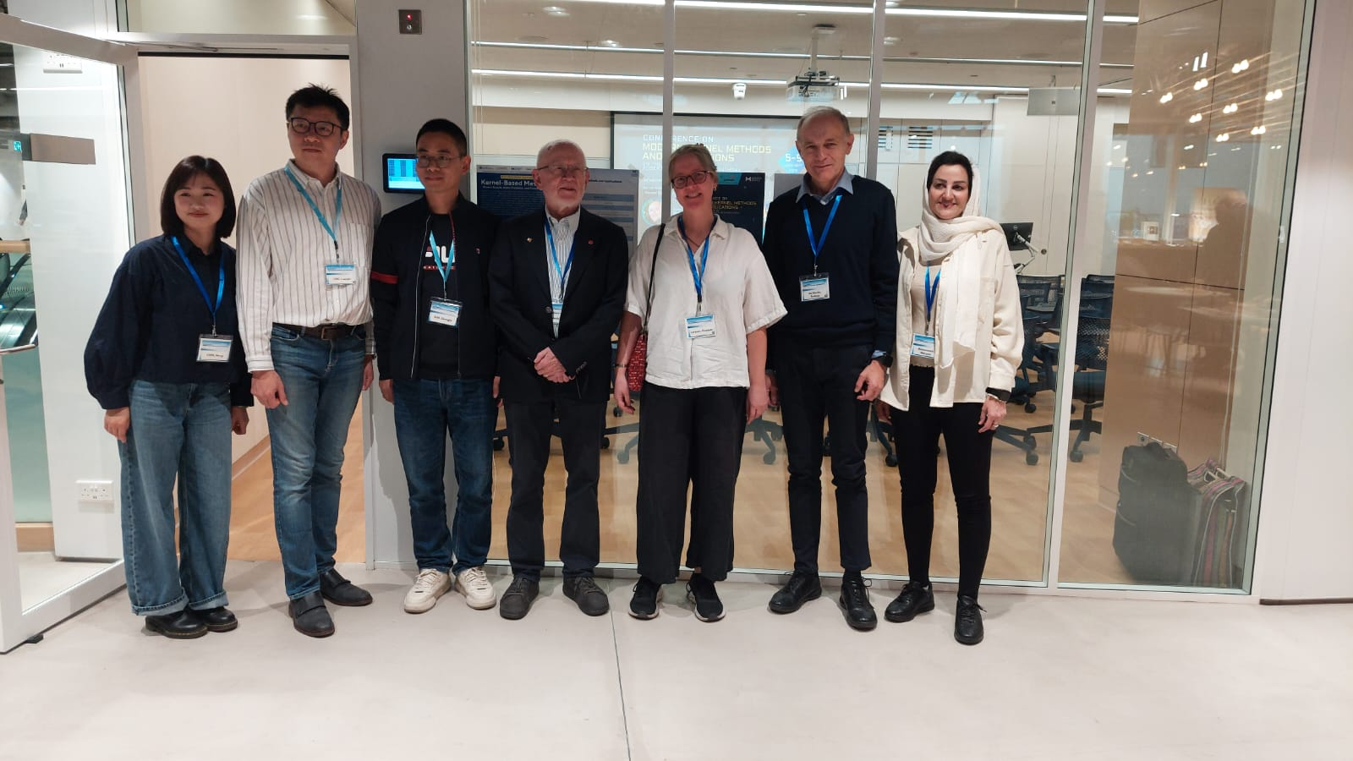
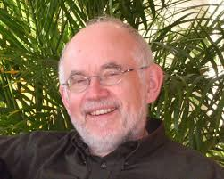
Dedicated to Robert Schaback on the occasion of his
80th birthday

Slide 3
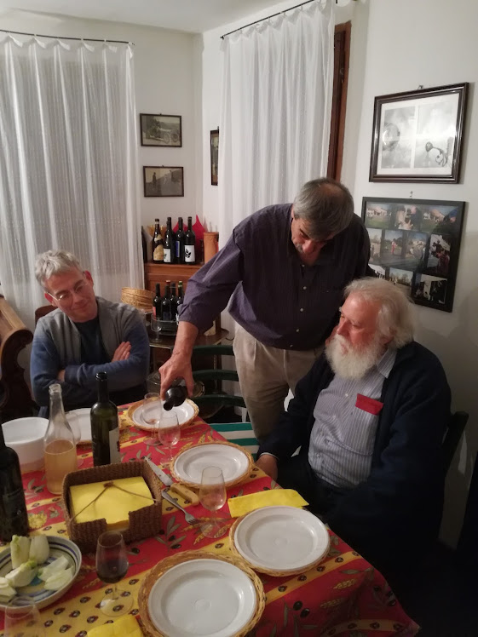
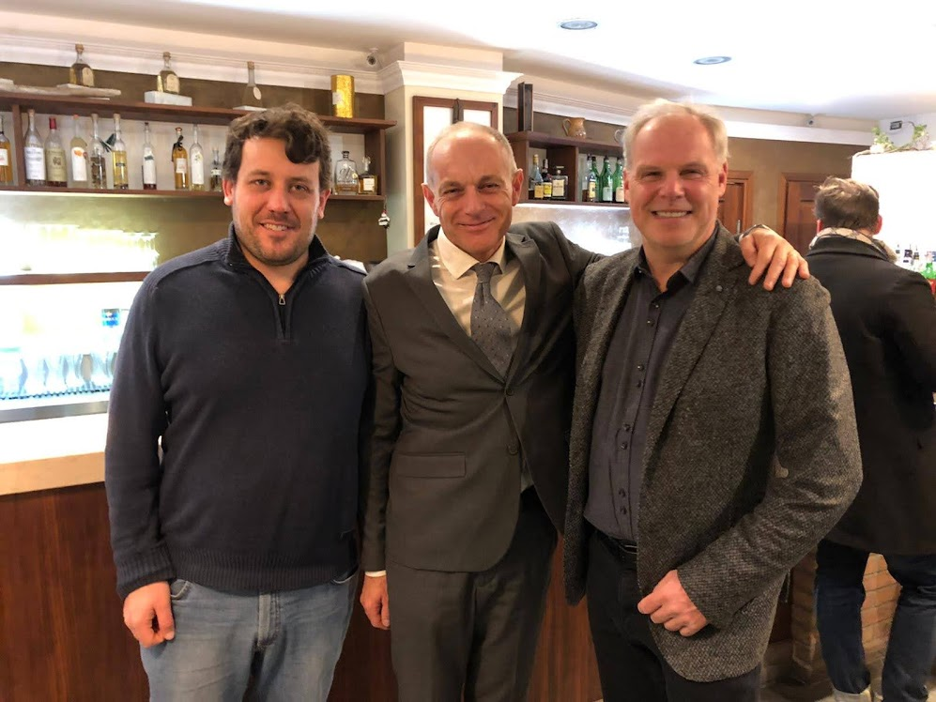
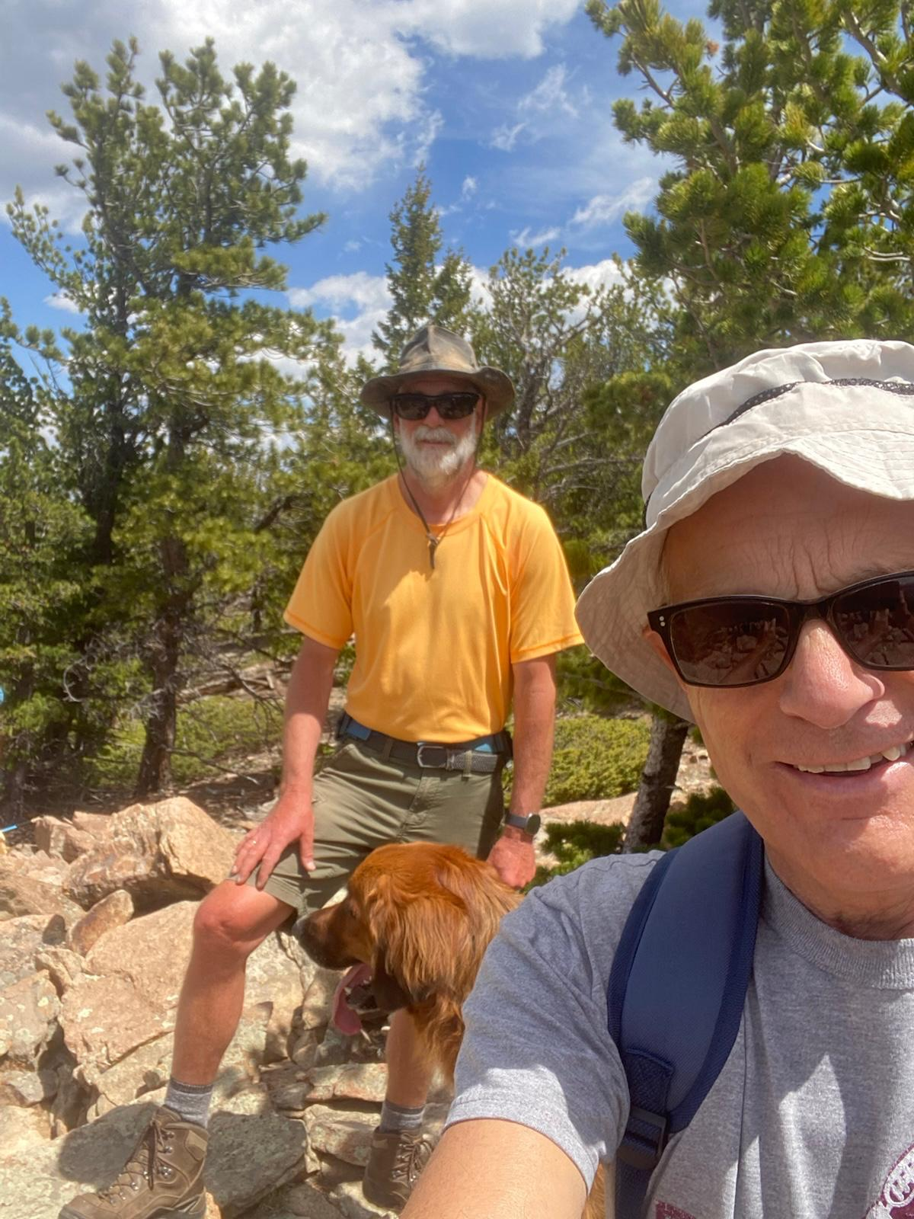
When first we met
1995: Greg Fasshauer (Nashville, SIAM CAGD)
1998: Martin Buhmann (Dortmund)
1999: Oleg Davydov (Giessen)
2000: Robert Schaback and Armin Iske (Firenze)
“Approssimazione di Curve e Superfici», Florence, 8-9 June 2000
2002: Holger Wendland (Göttingen)
Later on Christian Rieger, Janin Jäger, Bernard Haasdonk, etc …

Slide 4
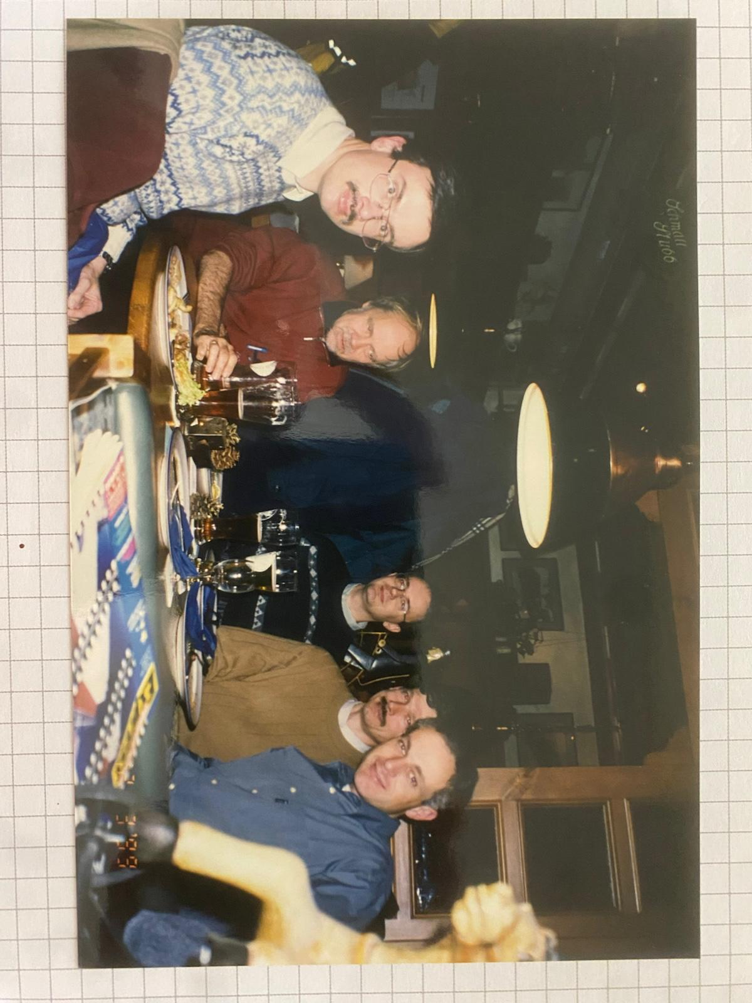
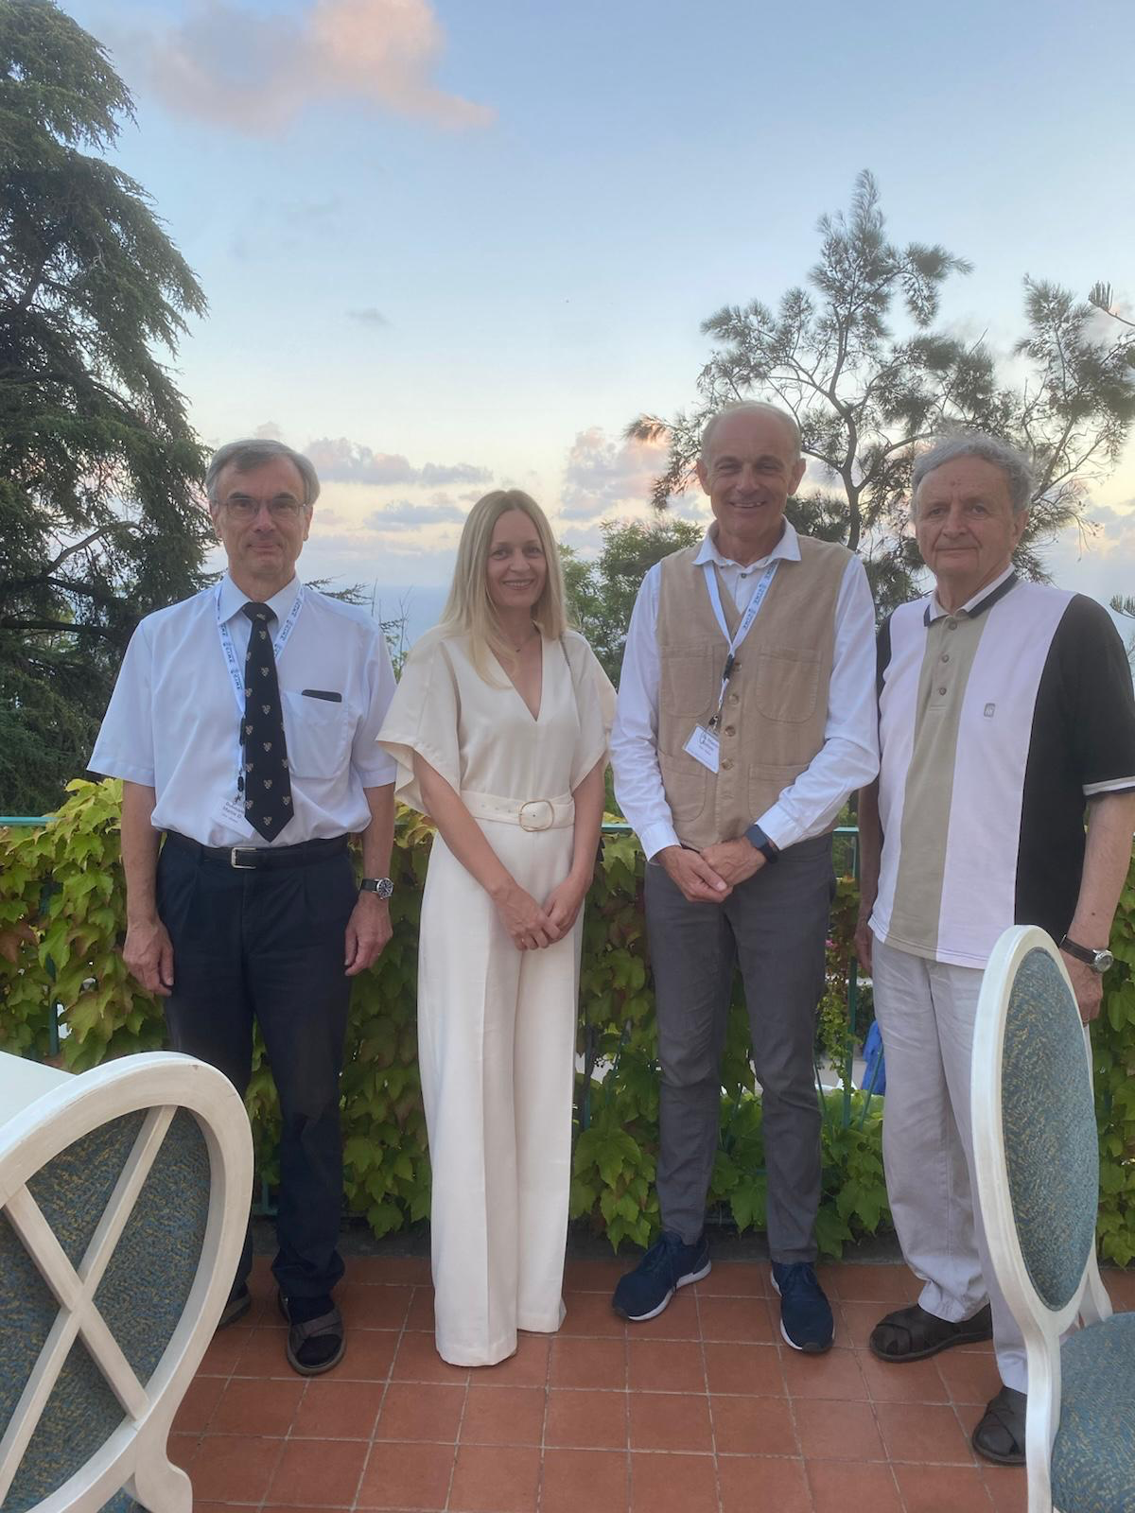
Giessen, December 1999
Cetraro CIME School, July 2025

Slide 5
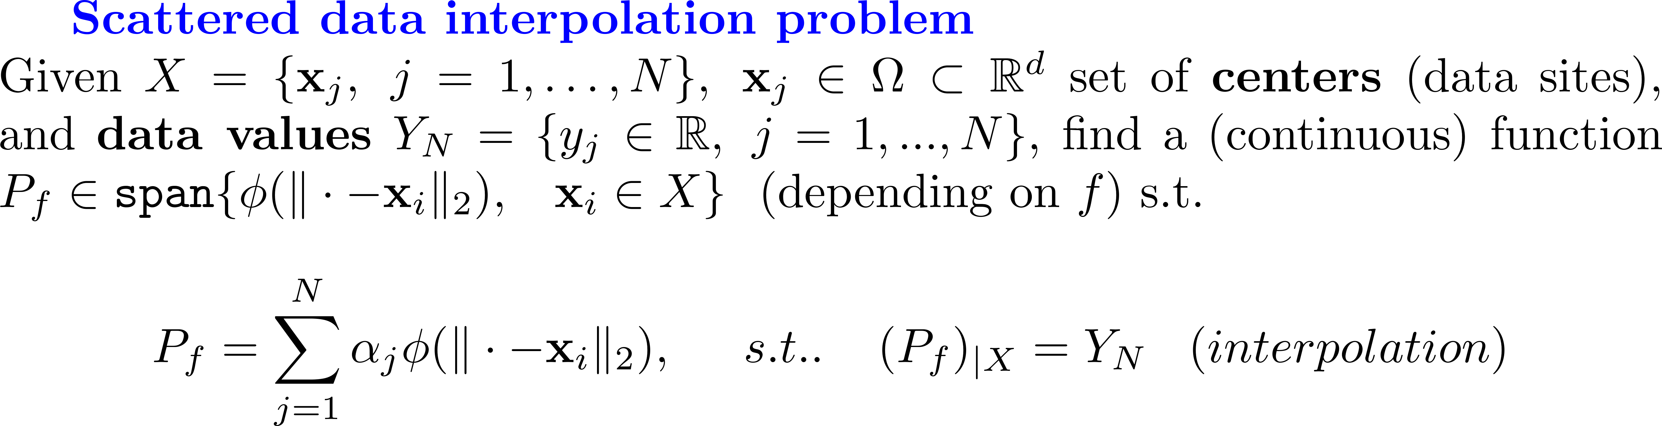
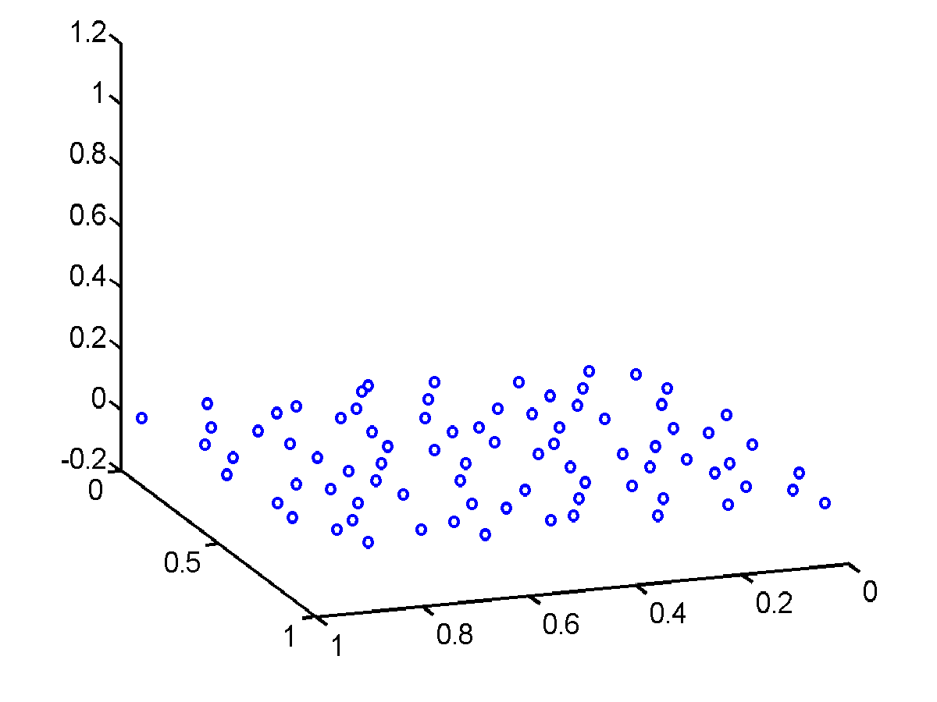
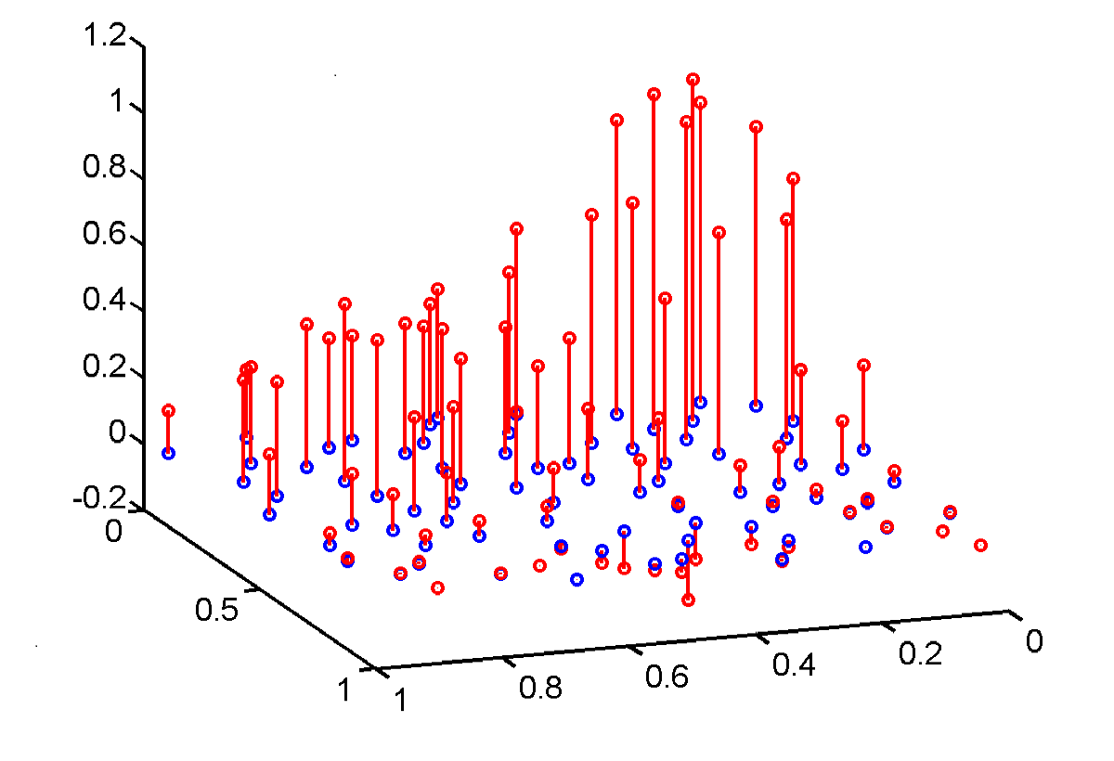
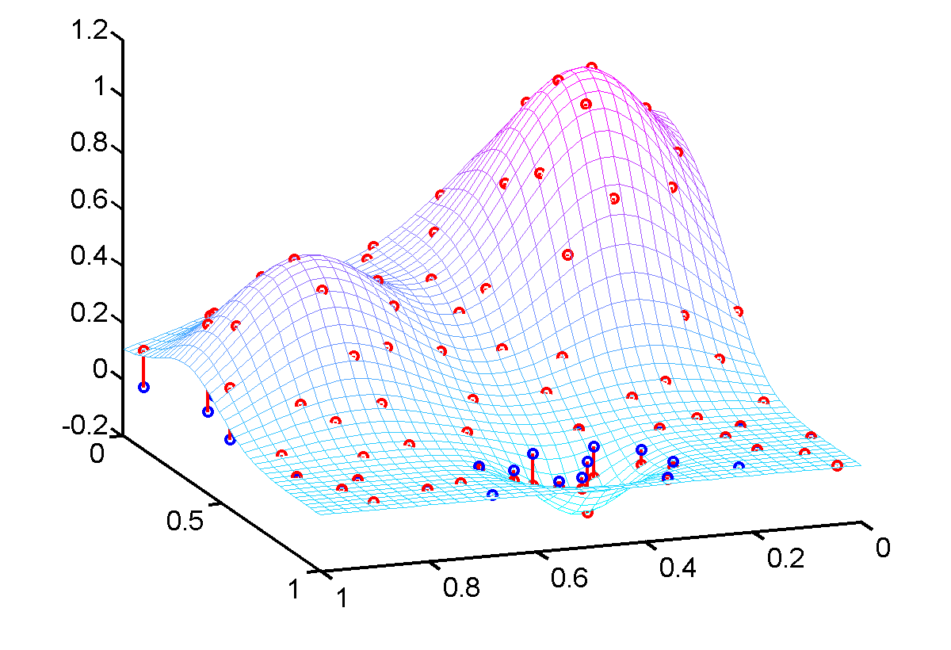


$$ϵ$$
$$ϵ$$

Slide 6
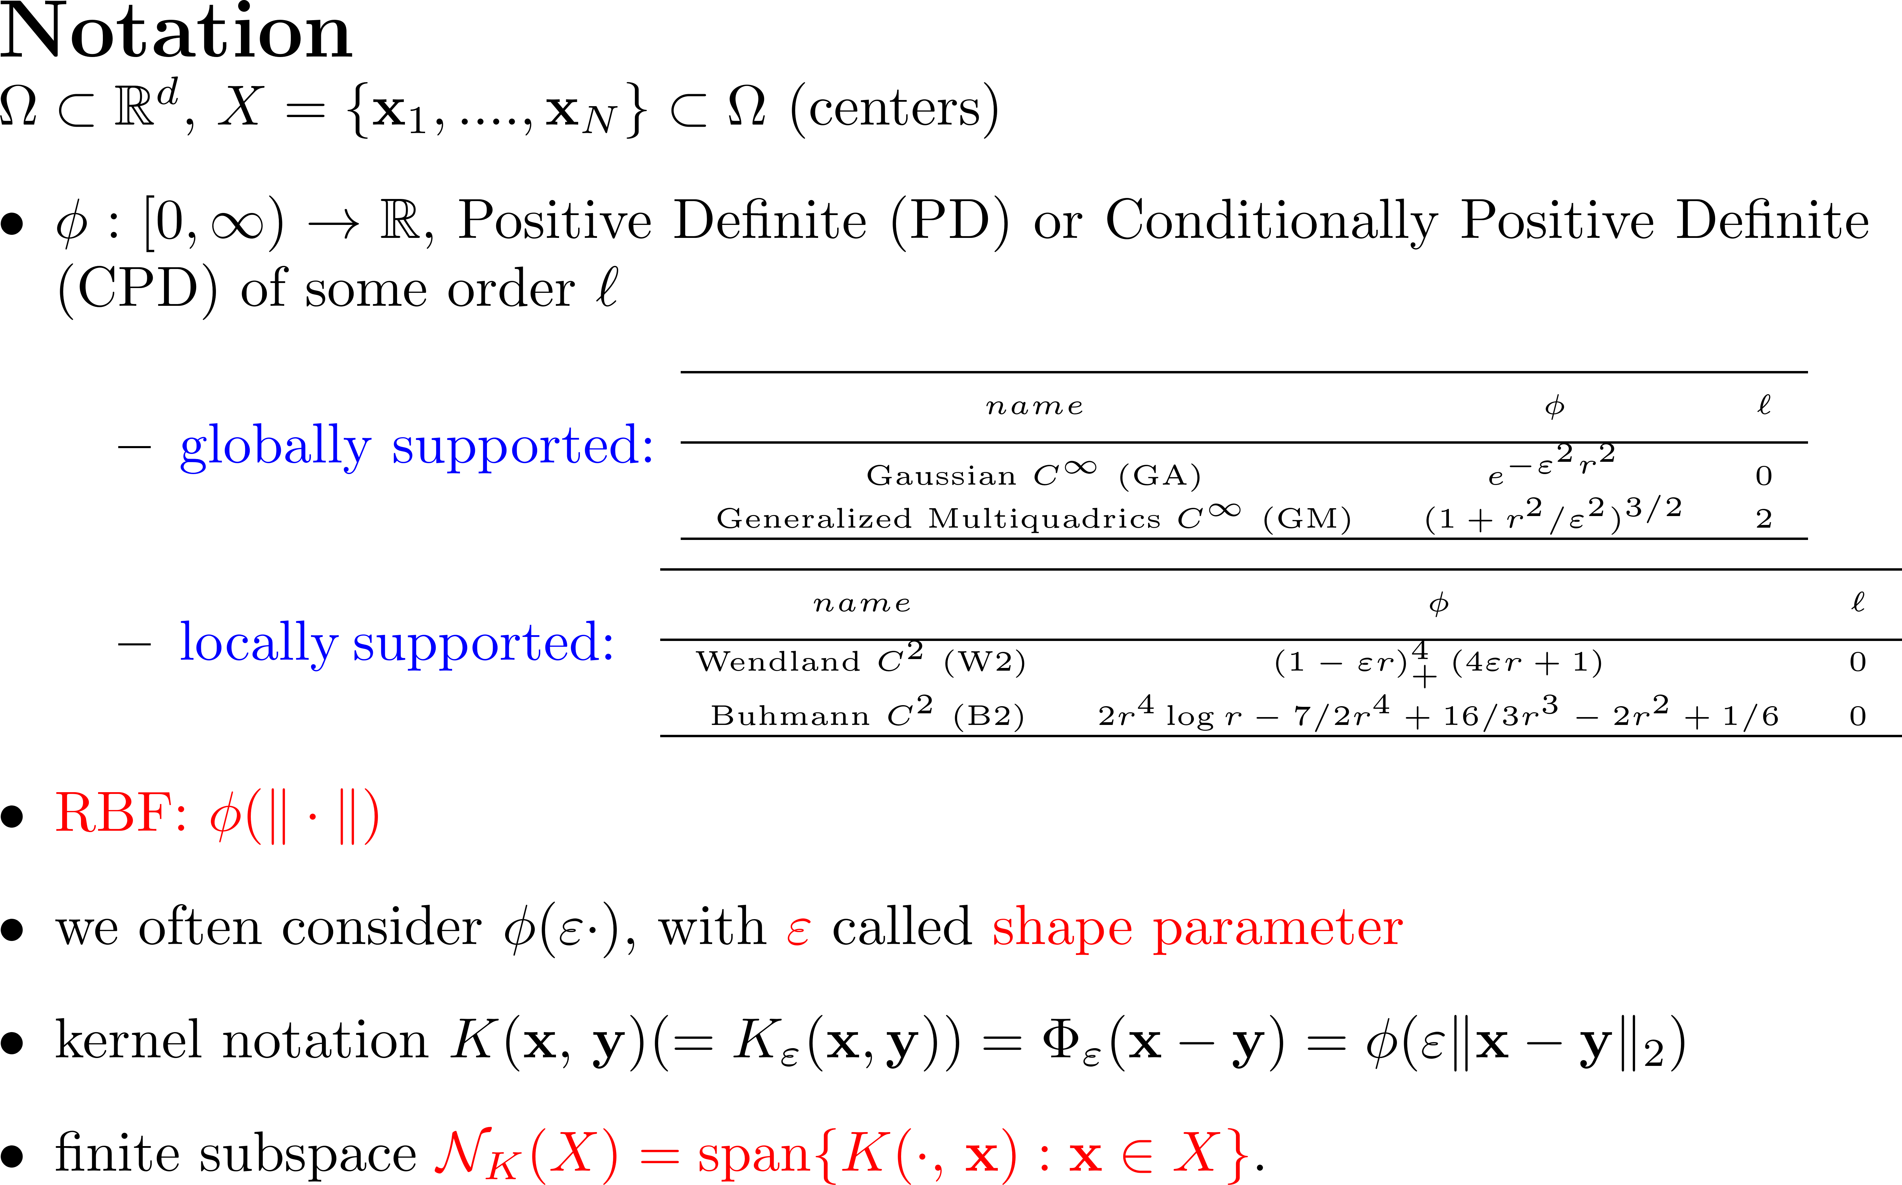

Slide 7
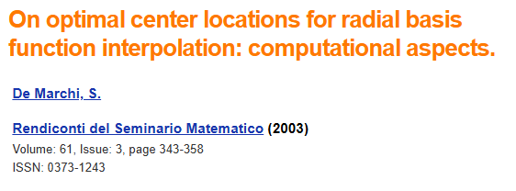
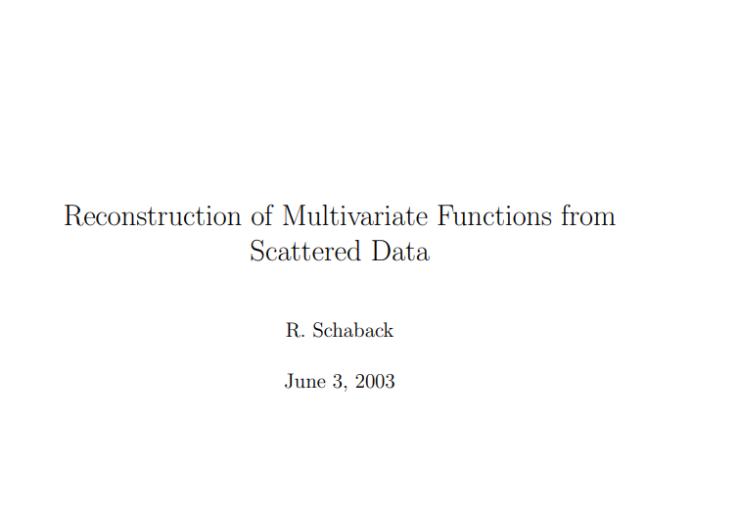
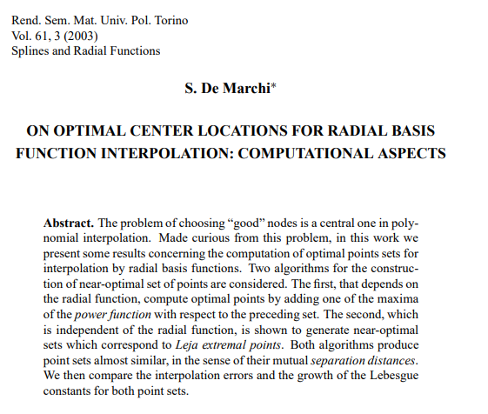
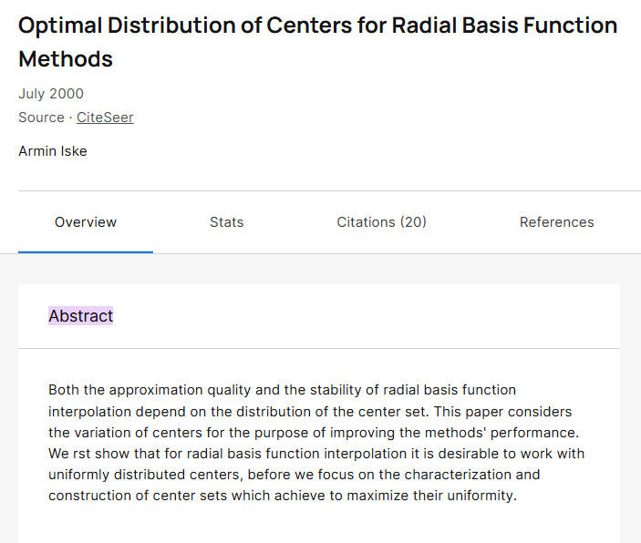
Göttingen, June and August 2001
TUM's Mathematics Reports (TUM-M0004)

Slide 8
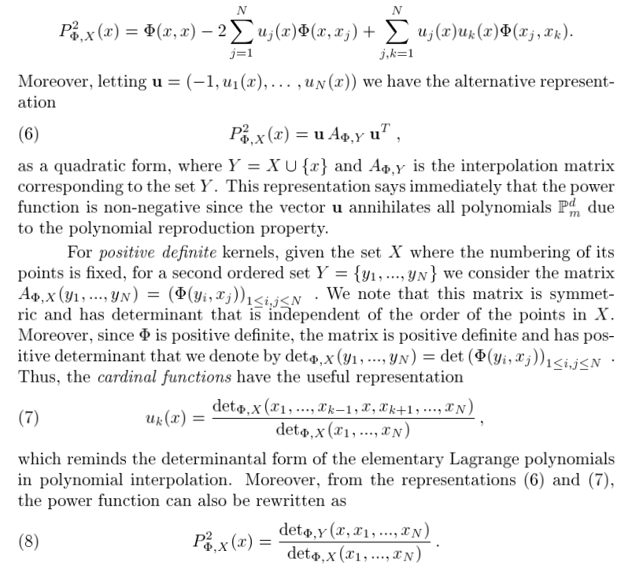
I learned how to write the power function as the ratio of two Vandermonde-like determinants

Slide 9
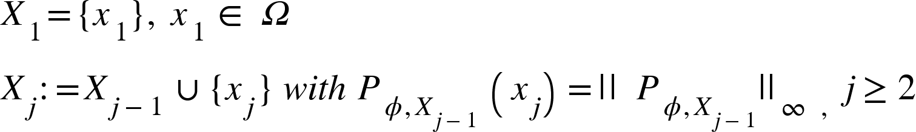
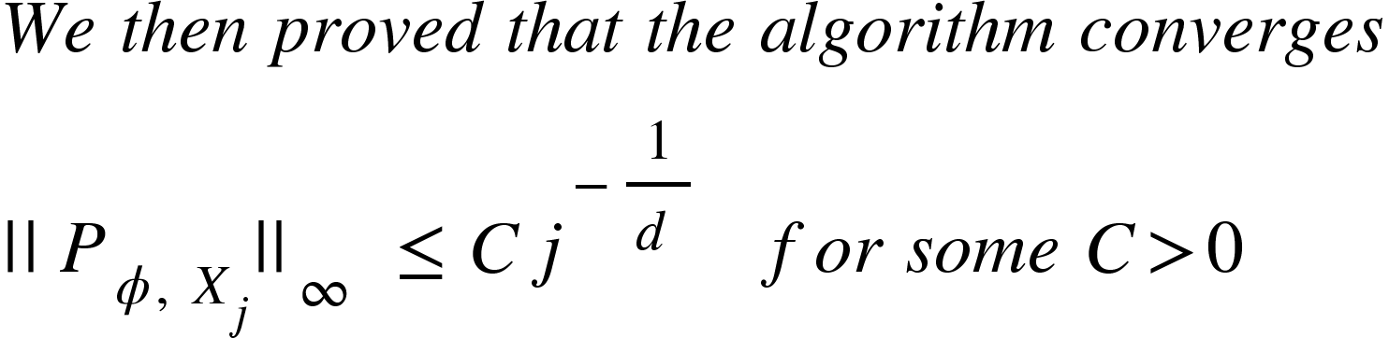

The practical method that produces well-distributed point sets was the greedy procedure based on the power function named p-greedy or data-independent [DeM, Schaback, Wendand, ACM2005]
a$t least like$
More on p-greedy convergence [Santin, Haasdonk DRNA 2017] and the data-dependent generalizations [Wenzel, Santin, Haasdonk CA 2023] and their applications [Herkert et al. Mathematics 2024], [Perracchione 2025], …

Slide 10
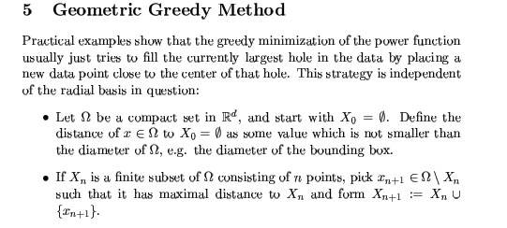
This strategy is similar to finding discrete Leja sequences or generelly discrete extemal sets (cf. [DeM 2003], [Caliari, DeM, Vianello 2005], [Bos, DeM, et al. 2011], [DeM, Piazzon et al. 2015])

Slide 11
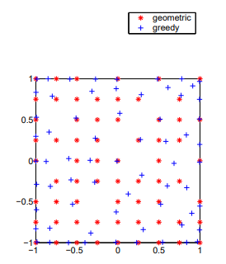
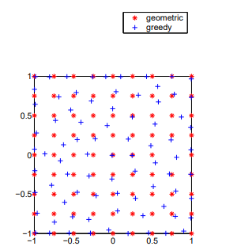
Left: 65 optimal points for the Gaussian with scale 1. Right: the points as computed by the geometric greedy algorithm (*) and the greedy algorithm (+).
Right: 80 points for Wendland’s C2.

Slide 12
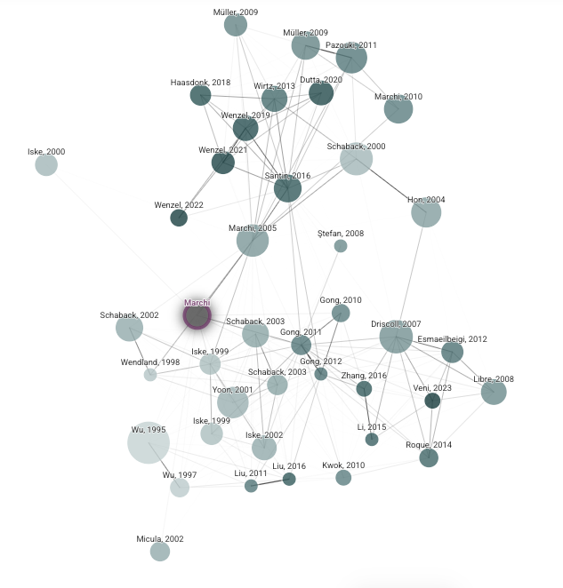
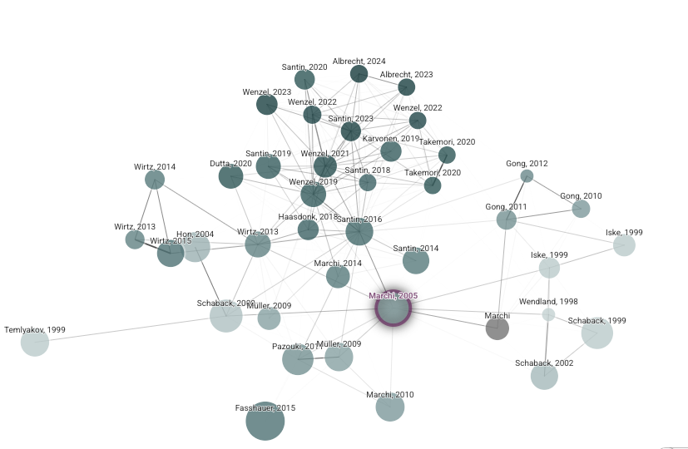
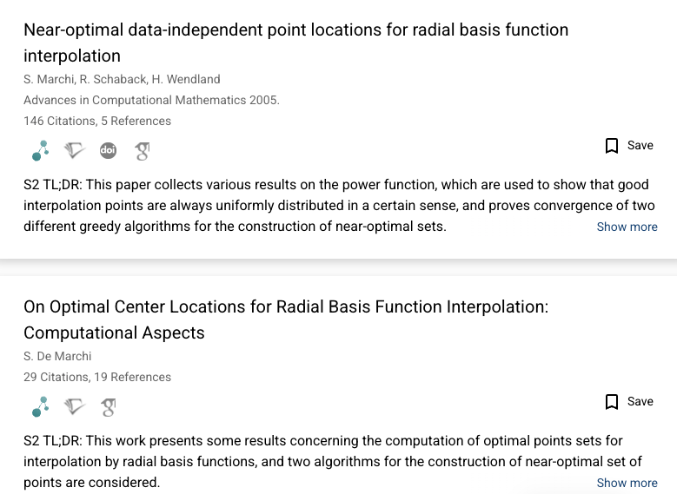
Semantic Scholar is a free, AI-powered search engine for scientific literature that helps researchers find, understand, and navigate academic papers more efficiently than traditional search
We may consider Kernel-based methods on graphs [Erb 2025]

Slide 13
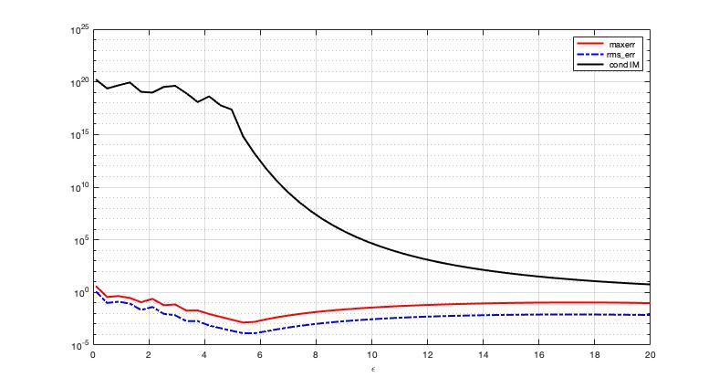
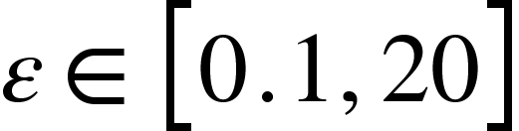
The uncertainty or trade-off principle [Schaback 1995]
Accuracy vs Stability
Accuracy&stabiliy vs Problem size
Accuracy vs Efficiency
RMSE, MAXERR and 2-Condition Number for the IM, with 50 values of
for interpolation of the Franke function on a uniform grid of 40x40 points

Slide 14
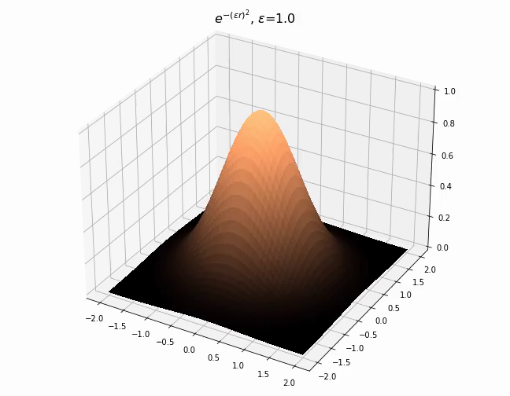
The role of the shape parameter
Contributions by
Cavoretto, De Rossi,
Larsson, Fasshauer, Fornberg,
Marchetti, Schaback,
Wright,…

Slide 15
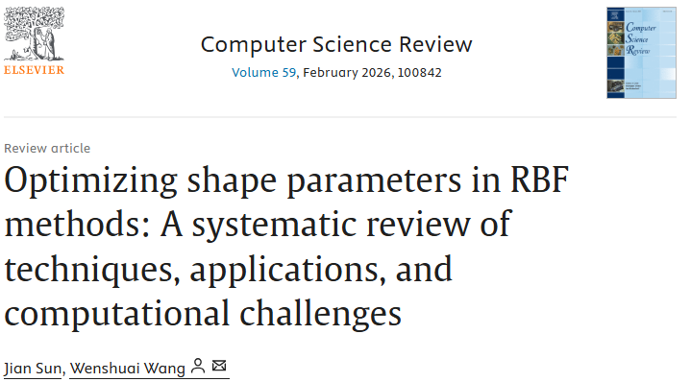
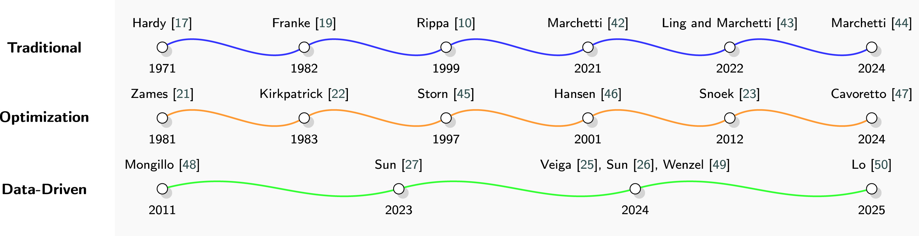
e.g. LOOCV-based
e.g. genetic-based
e.g. NN-based

Slide 16
RBF are nowadays commonly used in applied sciences
RBF as activation function for neural networks (RBF Networks) [M.J.L. Orr · 1996 · 1340 cit.]
RBF-morph in CFD applications https://www.rbf-morph.com/
Cancer evolution (for prostate cancer [V. Mohammadi,DeM,Dehghan 2021] … see Vahid’s talk.
Antenna design by using Rational RBF [Jacobsson et al. 2009], Rational CPD-RBF [Buhmann, DeM, Perracchione 2019]
Variably Scaled Persistent Kernels for TDA [Lot, Marchetti, DeM 2022] [Bandiziol & DeM 2024])
Solution of PDEs: Kansa, Fasshauer, Hassdonk, Larsson, Mirzaei, Rieger, Tominec, Wendland, Wenzel, Santin,….
… and many more apps!

Slide 17
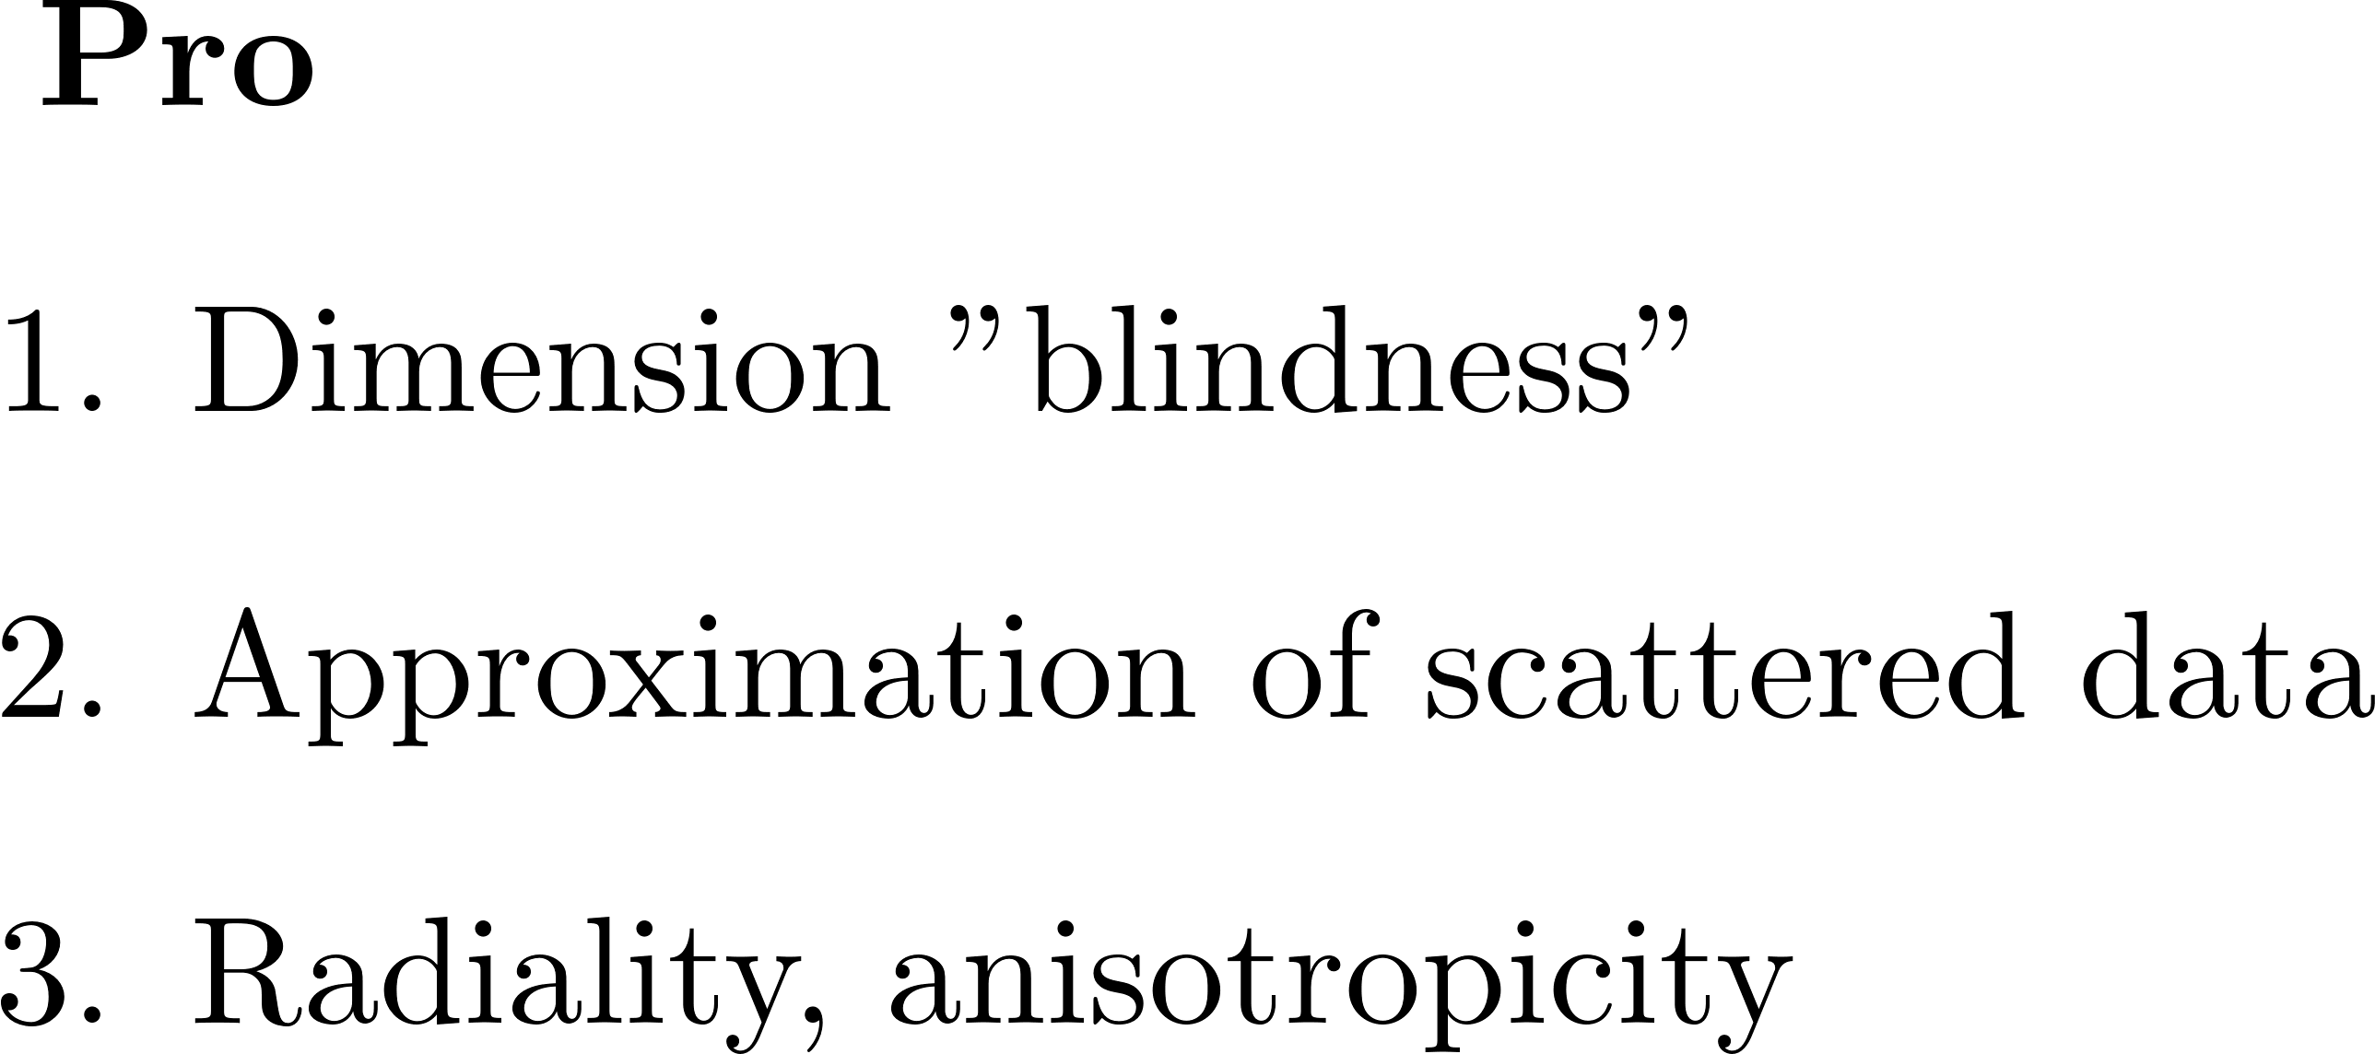
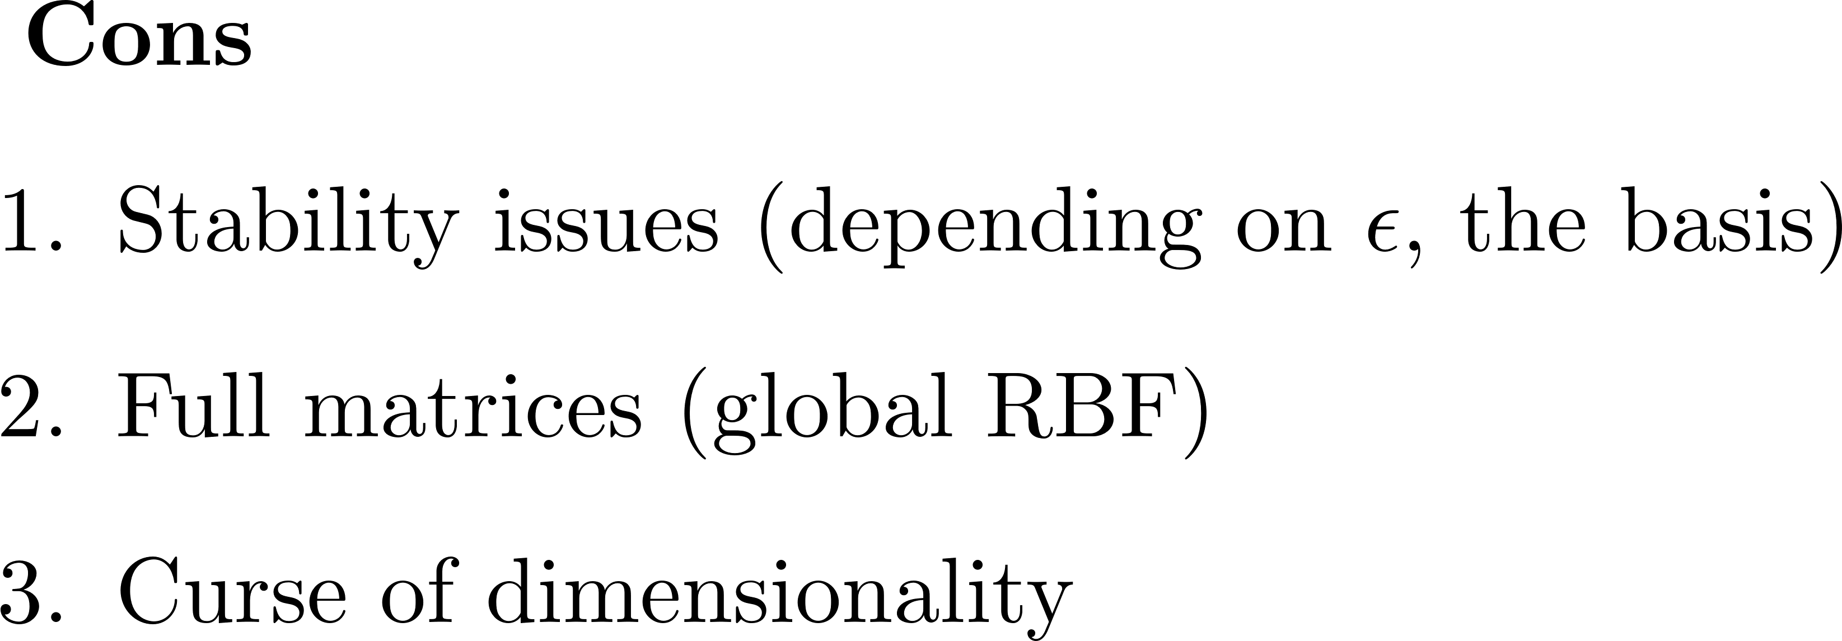
Some known pro and cons of RBF approximation
How to face these Cons?
Good centers [Iske 2000; DeM2003; DeM, Schaback, Wendland 2005], Stable Bases (RBF-QR, HS, WSVD,…) [Fornberg et al. 2011; Fasshauer&McCourt2012; Santin&DeM2013;…], CS-RBF (Wu, Wendland, Buhmann, Gneiting)
Preconditiong techniques [Beatson et al. 2010], [Egidi et al. 2023]
Greedy techniques [Haasdonk and collaborators 2018-20-23]
Variably Scaled Kernels (VSK) [Rossini et al. 2013] see Milvi’a talk , Variably Scaled Discontinuous Kernels [DeM et al. 2020]

Slide 18
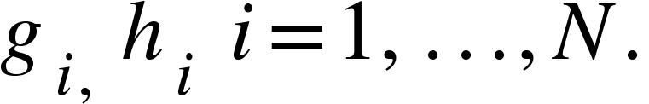
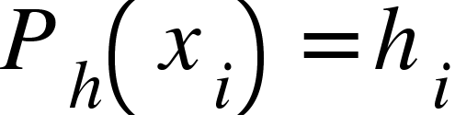
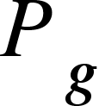
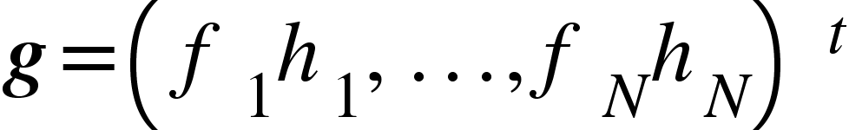


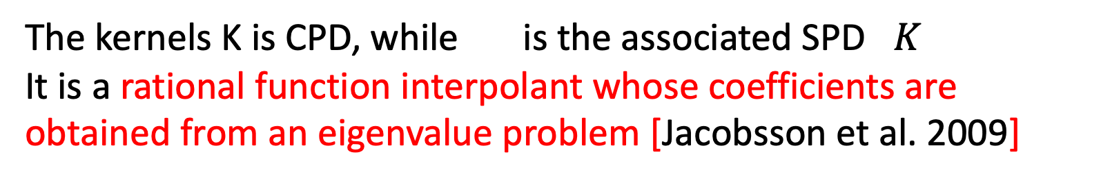
Rational RBF idea started from the Rescaled Localized RBF by [Deparis et al. 2014], [DeM, Idda, Santin 2017] [DeM, Wendland 2020]
The eigen-rational interpolant [Buhmann,DeM, Perracchione 2019]
It is defined for function values
Provided we compute in the standard way asking that interpolates
The kernels K is CPD, while is the associated SPD $K$
It is a rational function interpolant whose coefficients are obtained from an eigenvalue problem [Jacobsson et al. 2009]

Slide 19
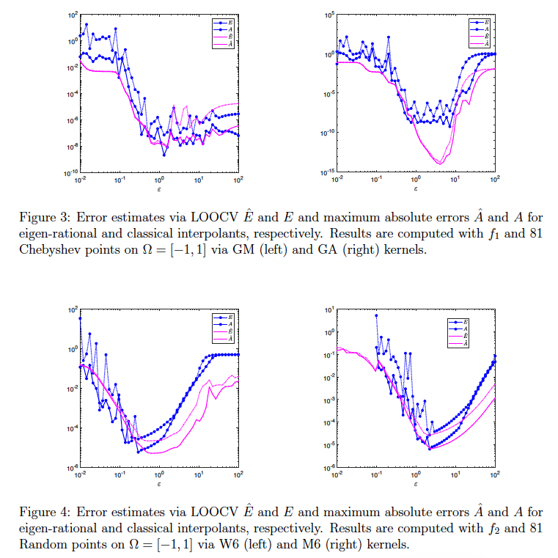
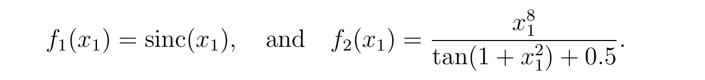

Slide 20
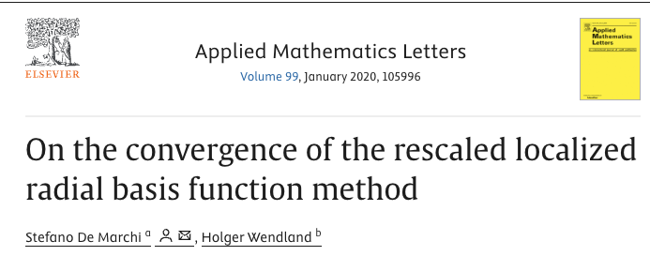


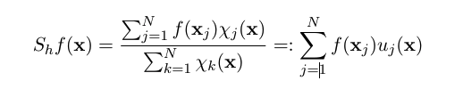
We discussed the convergence of the RL-RBF [Deparis et al. 2014] in the case of quasi-uniform and stationary scaling

Slide 21
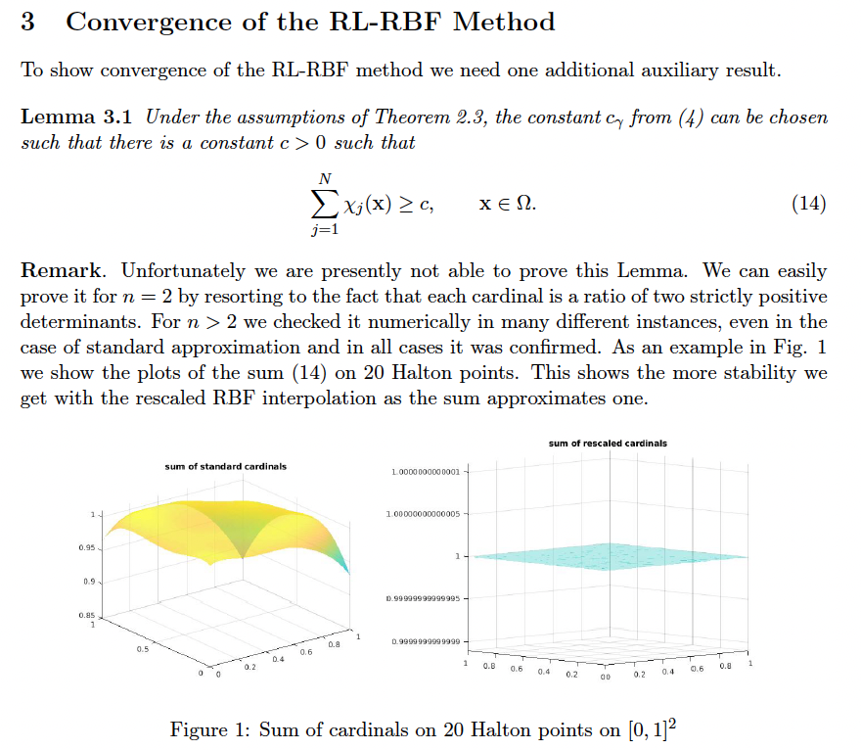

Slide 22
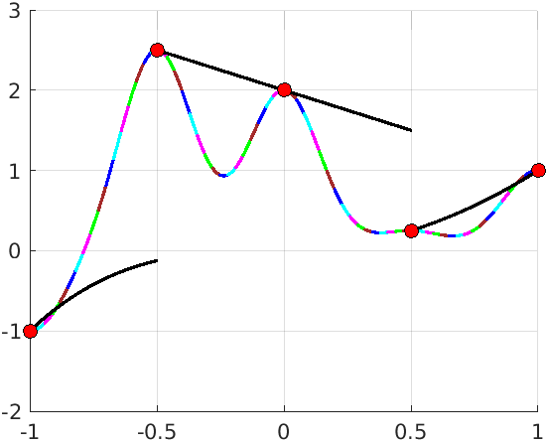
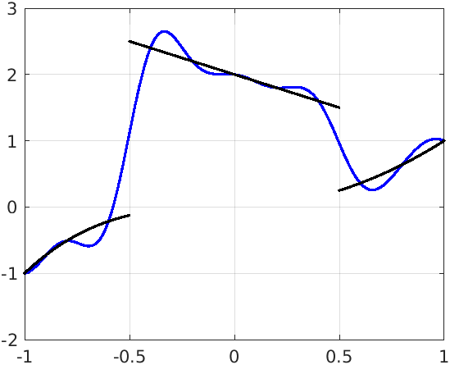
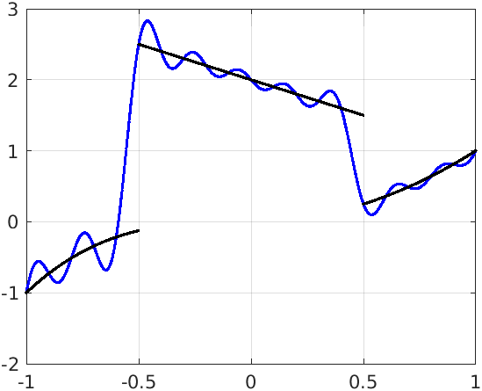
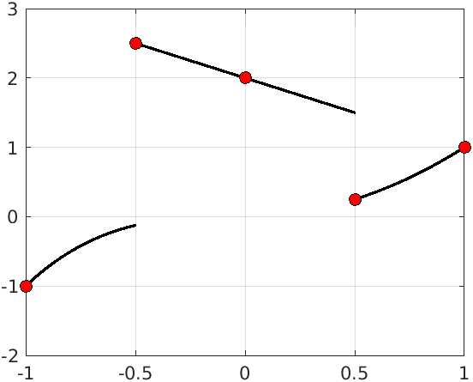
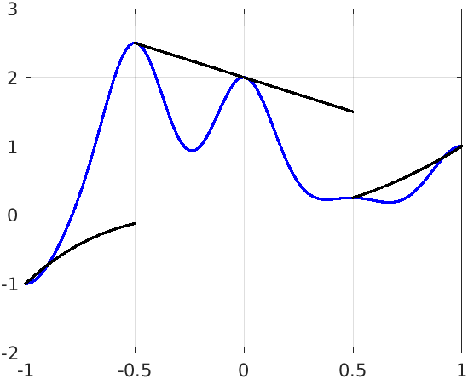
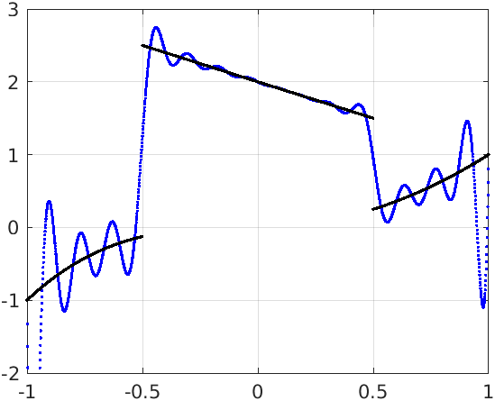





From kernel-based interpolation to VSK

Slide 23



Variably Scaled Kernels (VSK)
In machine learning, for SVM, this is equivalent to the kernel trick

Slide 24


S. De Marchi, F. Marchetti and E. Perracchione
Jumping with Variably Scaled Discontinuos Kernels (VSDK)
BIT Numerical Mathematics 60 (2020), pp. 441-463

Slide 25










Variably Scaled Discontinuous Kernels (VSDK)

Slide 26


Application of VSDK to MPI
First Left: sampling with Lissajous points; Middle Left: reconstruction with VSK;
Middle Right: edge detection: Right: reconstruction with VSDK
S. De Marchi, W. Erb, F. Marchetti, E. Perracchione and M. Rossini.
Shape-Driven Interpolation with Discontinuous Kernels: Error Analysis,
Edge Extraction and Applications in MPI
SIAM J. Sci. Comput. 42(2) (2020) pp. B472-B491,

Slide 27








Image reconstruction - VSDK

Slide 28




Support Vector Machines

Slide 29


Fasshauer-McCourt’ s book p. 39

Slide 30







SVM: complex boundaries (Kernel machine)

Slide 31
VSKs for SVM

Slide 32



Slide 33



Persistent (Homology) Kernels for TDA applications
Persistent Scale Space Kernel (PSSK)
Persistent Weighted Gaussian Kernel (PWGK)
Sliced Wasserstein Kernel (SWK)
Persistent Fisher Kernel (PFK)
Persistent Image (PI)
We can design Persistent Scaled kernels using the idea of VSK applied to the previous kernels

Slide 34














Some Books on RBF

Slide 35


Slide 36

RECAP AND ACKNOWLEDGMENTS
The German school of RBF, which has in Robert Schaback the mentor and leader for many of us, gave to me the opportunity to learn, share and develop a new field of research in Padova (and Italy)
What I have presented is an of what I learned!
I must acknwoledge all my co-authors but in particular my ex-students, Gabriele, Emma and Francesco (now professors), Mohammad, Cinzia for giving me the opportunity to study and develop new results (and …. contributed also to these slides!)

Slide 37
A friend of mine told me at my 60th celebration
«At 60, it is a good time for everyone to go through their friends!»
Robert, you are 80: here, online and around the world you have many friends, who are pround having you as mentor, colleague and friend.
Thank you Robert, from the deepest of my heart, to be part of this long list

Slide 38


