Slide 1
A logic for true concurrency
Paolo Baldan and Silvia Crafa
Universita’ di Padova

Slide 2
Models of Concurrency
?
a | b = a.b + b.a
a
b
b
a
Different causal properties
Different distribution properties

Slide 3
The Interleaving world
Bisimulation equivalence
2-nested simulation
a | b ~ a.b+b.a
ready simulation
simulation equiv.
ready trace equiv.
completed trace eq.
Trace equivalence

Slide 4
The True-Concurrent world
Hereditary history-preserving bisim
a | b ≠ a.b+b.a
History-preserving bisim
Pomset bisimulation
weak hp bisim
Step bisimulation
( Bisimulation equivalence )

Slide 5
Interleaving world: Logical characterization
Hennessy-Milner Logic
HML
Bisimulation equiv.
HML without
negation
simulation equiv.
HML without
negation and conjunction
Trace equiv.

Slide 6
True-concurrent world vs Logic ?
??
Hereditary hp- bisim
Hennessy-Milner Logic
Bisimulation equiv.

Slide 7
Logics for true-concurrency
[DeNicola-Ferrari 90]
Unique framework for several temporal and modal logics.
Captures pomset bisim and weak hp-bisim.
[Hennessy-Stirling 85, Nielsen-Clausen 95]
Charaterise hhp-bis with past-tense/back step modalities
In absence of autoconcurrency
[Bradfield-Froschle 02, Gutierrez 09]
Modal logics expressing action independence/causality
Only hp-bisimulation is captured
Different logics for different equivalences!!

Slide 8
A single logic for true-concurrency
L
Hereditary hp- bisim
L _{hp}
hp bisim
L _{p}
Pomset bisim
L _{s}
Step bisim
Hennessy-Milner Logic
Bisimulation equiv.

Slide 9
True Concurrent Model: Event Structures
Computation in terms of events = action occurrence
A notion of causal dependence between events
A notion of incompatibility between events
A labeling to record the action corresponding to the event
E = ( E, ≤ , #, λ )
≤ is a partial order and is finite
# is irreflexive, symmetric and hereditary: if e # e’ ≤ e’’ then e#e’’

Slide 10
True Concurrent Model: Event Structures
d
e
e₄
e₅
e₃
c
e₆
c
e₁
a
b
e₂
a
autoconcurrency
e₄ is caused by {e₁, e₂, e₃}
(e₁, e₂) and (e₁, e₆) are concurrent
(e₃, e₆) and (e₅, e₆) are in conflict
(e₂, e₄) and (e₁, e₆) are consistent

Slide 11
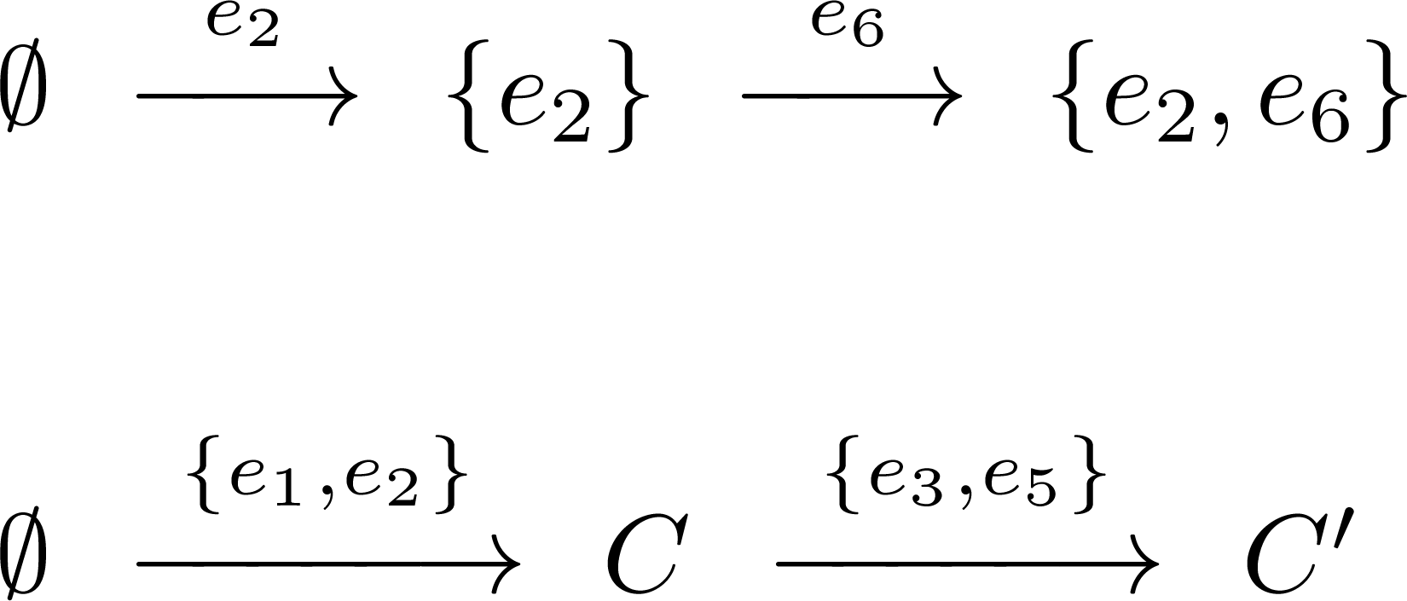
True Concurrent Model: Event Structures
e₄
e₅
Computation
in terms of Configurations
e₃
e₆
causally-closed set of consistent events
e₁
e₂
pomset
a run
step

Slide 12
The True Concurrent Spectrum
Coherent hhp-bisim
Hereditary history-preserving bisim
History-preserving bisimulation
Pomset bisimulation
weak hp bisim
Step bisimulation
( Bisimulation equivalence )

Slide 13
Bisimulation Equivalence

Slide 14
Bisimulation Equivalence
It captures the branching of a system
b
c
b
c
a.b +a.c
≠
a.(b+c)
a
a
a
but it cannot observe the concurrency of a system
b
a
=
a.b +b.a
a
b
a | b
a
b

Slide 15
Bisimulation Equivalence
it cannot observe the concurrency of a system
b
a
=
a.b +b.a
a
b
a | b
a
b

Slide 16
Step Bisimulation

Slide 17
Step Bisimulation
It captures the concurrency of a system
b
a
≠
a | b
a.b +b.a
s
a
b
a
b
but it cannot observe the concurrency / causality mix:
b
b
=
s
or
a
b
a
b
a
a
b
There is an occurrence of b
causally dependent from a

Slide 18
Step Bisimulation
It captures the concurrency of a system
but it cannot observe the concurrency / causality mix:
b
=
s
a
b
a
b
There is an occurrence of b
causally dependent from a

Slide 19
Pomset Bisimulation

Slide 20
Pomset Bisimulation
It captures the causality of a system
b
≠
a
b
p
a
b
but it cannot observe the causality / branching mix:
b
b
=
p
The same pomsets but
only in the lhs
“after a we can choose
between a dependent and an
independent b”
a
b
a
b
a

Slide 21
Pomset Bisimulation
like bisimulation:
it is an interleaving of pomsets (rather than actions)
it doesn’t observe the causal relations between a pomset and the next one
keep the history of already matched transitions
Let the two matching runs (entire history of moves) in the game to be pomset-isomorphic
let the history grow pomset-isomorphically

Slide 22
History-preserving Bisimulation

Slide 23
History-preserving Bisimulation
It captures the causality / branching interplay
“causal equivalence”
?
=
?
b
p
b
≠
hp
a
b
a
b
a
It does not capture the interplay between
causality – concurrency - branching

Slide 24
History-preserving Bisimulation
c
d
=
c
d
hp
a
b
#
a
b
a
b
#
a
b
And similarly the other way round
c and d depend on conflicting vs. concurrent a and b !!
Hp-bisim hides such a difference:
the execution of an event rules out any conflicting event
there is the same causality

Slide 25
History-preserving Bisimulation
c
d
=
c
d
hp
a₁
b₁
#
a₂
b₂
a₁’
b₁’
#
a₂’
b₂’
a₁, b₁ can be matched in principle either by a₁’, b₁’ or a₂’, b₂’
the choice depends on the order in which they are linearized (a₁, b₁ are concurrent)
a₁, b₁ are independent, but the execution of one affects the “behavioral environment”/ the future of the other
How can we formalize this difference?

Slide 26
Hereditary History-preserving Bisimulation
Backward moves!!
?
c
d
≠
c
d
hhp
a₁
b₁
#
a₂
b₂
a₁’
b₁’
#
a₂’
b₂’
a1
b1
a1
d
→
→
←
→
a2’
b2’
a2’
d
→
→
←
→

Slide 27
Hereditary History-preserving Bisimulation
a|(b+c) + a|b + b|(a+c) a|(b+c) + b|(a+c)
a
b
c
#
a
b
#
a
c
b
a
b
c
#
a
c
b
no causality
In lhs only: a couple of independent (a,b) so that none can appear in parallel with c
Hp-bisim hides such a difference
a and b are independent but their linearization affects the behavioral environment
The backtracking distinguishes them

Slide 28
Hereditary History-preserving Bisimulation
The backtracking can distinguish them
a|(b+c) + a|b + b|(a+c) a|(b+c) + b|(a+c)
a
b
c
#
a
b
#
a
c
b
?
a₁
b₁
c₁
#
a₂
c₂
b₂
a
b
a
c
→
→
←
→
a2
b2
a2
c
→
→
←
→

Slide 29
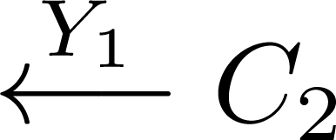
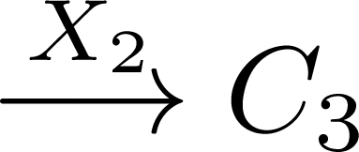
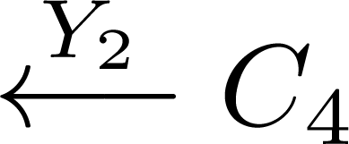
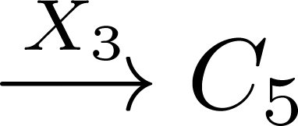
Hereditary History-preserving Bisimulation
What kind of forward observation does backtracking correspond to?
alternative,
possibly conflicting
futures

Slide 30
A logic for true concurrency
Var : denumerable set of variables ranged over by x, y, z, …
Interpreted over event structures:
a formula is evaluated in a configuration C, with an environment η : Var → E
describes a set of
possible futures
for C
the current state of the computation
records the events
bound to variables

Slide 31
A logic for true concurrency
Event-based logic
it binds z to e so that it can be later referred to in φ
declares the existence of an event e in the future of C s.t.
the event η(z) can be executed form C, leading to C’ s.t.

Slide 32
A logic for true concurrency
there is a future evolution that enables b
b
d
there are two (incompatible) futures
a
c
executing a disallows the future containing d
b
d
a
b
d
a

Slide 33
Examples and notation
Immediate execution
stands for
that chooses an event and
immediately executes it
Step
stands for
which declares
the existence of two concurrent events

Slide 34
Well-formedness
The full logic is too powerful: it also observe conflicts!
b
b
b
a
a
a
Well-formedness syntactically ensures that
free variables in any subformula will always refer to events consistent with the current config.
the variables used as causes/non causes in quantifications will be bound to consistent events

Slide 35
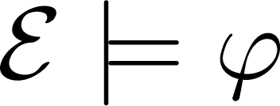
Logical Equivalence
An e.s. satisfies a closed formula φ: when
Two e.s. are logically equivalent in the logic L: when
Theorem:
The logical equivalence induced by the full logic is hhp-bisimilarity

Slide 36
A single logic for true-concurrency
L
Hereditary hp- bisim
no back moves
L _{hp}
hp bisim
L _{p}
Pomset bisim
L _{s}
Step bisim
Hennessy-Milner Logic
Bisimulation equiv.

Slide 37
Logical Spectrum: HM Logic
Hennessy-Milner logic corresponds to the fragment L_{HM} :
No references to causally dependent/concurrent events
Whenever we state the existence of an event, we must execute it
Theorem:
The logical equivalence induced by L_{HM} is bisimilarity

Slide 38
Logical Spectrum: Step Logic
The fragment L_{s} :
Predicates on the possibility of performing a parallel step
No references to causally dependent/concurrent events between steps
Generalizes L_{HM}
Theorem:
The logical equivalence induced by L_{s} is step bisimulation

Slide 39
Logical Spectrum: Pomset Logic
The fragment L_{p} :
where ¬ , ˄ are used only on closed formulae
Predicates on the possibility of executing a pomset transition
Closed formula ↔ execution of a pomset
Causal links only within a pomset but not between different pomsets
Theorem:
The logical equivalence induced by L_{p} is pomset bisimulation

Slide 40
Logical Spectrum: History Preserving Logic
The fragment L_{hp} :
Besides pomset execution, it also predicates about its dependencies with previously executed events
quantify + execute → no quantification over conflicting events
Theorem:
The logical equivalence induced by L_{hp} is hp-bisimulation

Slide 41
Logical Spectrum: Separation Examples
b
a
a
b
a
b
b
a
b
a
b

Slide 42
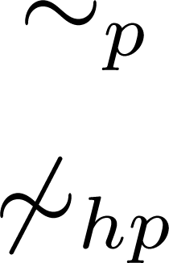
Logical Spectrum: Separation Examples
b
b
The same pomsets but
only in the lhs
“after a we can choose
between a dependent and an
independent b”
a
b
a
b
a

Slide 43
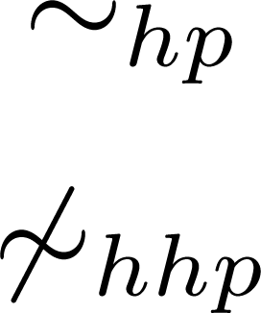
Logical Spectrum: Separation Examples
c
d
c
d
a
b
#
a
b
a
b
#
a
b
The same causality but
c and d depend on conflicting vs. concurrent a and b
observe without executing:
conflicting futures
!!

Slide 44
Logical Spectrum: Separation Examples
a|(b+c) + a|b + b|(a+c) a|(b+c) + b|(a+c)
The same causality but in lhs only
a couple of independent (a,b) so that
none can appear in parallel with c
observe without executing:

Slide 45
Future work
Different equivalences in a simple, unitary logical framework
Study the operational spectrum:
observe without executing, but only predicate on consistent futures lies in between hp and hhp-bis.
hp is decidable and hhp is undecidable even for finite state systems. Characterise decidable equiv.
Study the logical spectrum:
encode other logics in L
add recursion to express properties like
any a-action can be always followed by a causally related b-action
an a-action can be always executed in parallel with a b-action
Verification: model checking, auotmata, games,…

