Slide 1
Process-aware Information Systems for Emergency Management
Dr. Massimiliano de Leoni
Department of Mathematics and Computer Science
http://www.win.tue.nl/~mdeleoni/
m.d.leoni@tue.nl

Slide 2
Fundamentals
Workflow
  “The automation of a business process, in whole or part, during which documents, information or tasks are passed from one participant to another for action according to a set of procedural rules.”
  WfMC, Terminology & Glossary, WFMC-TC-1011 3.0, February 1999
Workflow Management System (WfMS)
  a.k.a. Business Process Management Systems (BPMS)
  “A system that completely defines, manages and executes workflows through the execution of software whose order of execution is driven by a computer representation of the workflow logic.”
  WfMC, Terminology & Glossary, WFMC-TC-1011 3.0, February 1999
Process-aware Information Systems:
  “A software system that manages and executes operational processes involving people, applications, and/or resources on the bases of process models.”
  M. Dumas, W. van der Aalst, A. ter Hofstede, Process-Aware Information Systems: Bridging People and Software through Process Technology, John Wiley & Sons, 2005

Slide 3
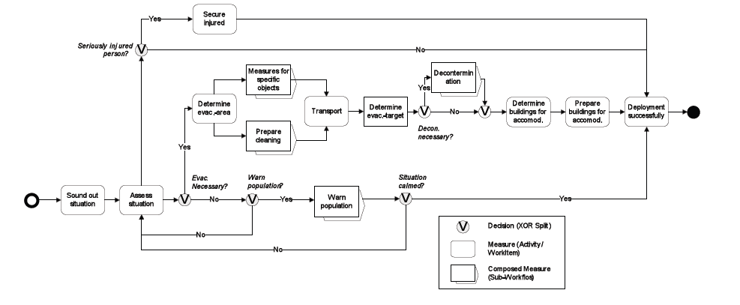
Process Model for Emergency Management
Sub Processes: A hierarchical decomposition of the process in sub parts
Tasks : The actual piece of work to be executed
Decision Points : Alternative Branches according to some conditions on the process data

Slide 4
BPM Life-Cycle
Process Mining
Business Process
Management System
Business Process Modelling Tools
  A. ter Hofstede, W. van der Aalst, M. Adams, N. Russell, Modern Business Process Automation: YAWL and its Support Environment, Springer, 2009

Slide 5
The life-cycle of Emergency Management
Analysis of past Emergencies to evaluate the risk of happening again and potential consequences
Reduction of the probability of a new occurrence and analysis of the activities needed to mitigate the consequence when occurring
EMERGENCY
Actual performance of the contingency plans designed in the Preparedness phase
Development of plans (i.e. processes) to save lives and minimize disaster damages and, in general, consequences
Plans to return to the live conditions comparable with those before the emergency
  Sven H. Leitinger, Comparision of GIS-based Public Safety Systems For Emergency Management , Proc. 24th Urban Data Management Symposium, 2004

Slide 6
Emergency-Management Systems as Process-aware Information Systems
Based on several studies of emergency plans and end-user inteviews, emergency plans are very similar to business processes.
  Business processes are meant to achieve objectives
  Emergency plans are a special case, where the objective is to manage thr emergency at the best
The two life cycles can also match each other

Slide 7
Summary
Basic Process-aware Information Systems (PAISs) requirements for the domain of emergency management
Overview of the nowadays’ literature on PAIS for Emergency Management
The WORKPAD Approach
  WORKPAD has been an European-funded project to develop:
    A pervasive system to foster and support the collaboration inside the civil-protection teams acting on the spot
    A peer-to-peer infrastructure to integrate the information at the headquarters of the organizations involved
  The project concluded with a real drill on the spot with the involvement of civil-protection units

Slide 8
Emergency Management Requirements
Jul [1] reflects the American disaster management practices, investigating how the disaster size influences the response type.
The results are also conformed by:
  The experience of the WORKPAD project and the final drill [2]
  A joint analysis with German civil-protection officers [3]
  S. Jul, Who’s Really on First? A Domain-Level User and Context Analysis for Response Technology, Proc. of 3th International Conference on Information Systems for Crisis Response and Management (ISCRAM), 2007
  M. de Leoni et al., The WORKPAD Project Experience: Improving the Disaster Response through Process Management and Geo Collaboration, Proc. of the 7th International Conference on Information Systems for Crisis Response and Management (ISCRAM), 2010
  D. Hagebölling, M. de Leoni,Supporting Emergency Management through Process-Aware Information Systems. Business Process Management Workshops, 2008

Slide 9
Classification in three calamity types
Emergency: short-lived event whose effects are localized in a single community (e.g., a house explosion because of gas leakage)
Disaster: long-lived event affecting many communities, but community and response infrastructures are mostly intact (e.g., 9/11 terrorist attacks)
Catastrophe: long-lived event affecting hundreds of communities, destroying almost every infrastructure and damaging the response systems (e.g., 2005 Hurricane Katrina)
Local emergency do not require an extensive PAIS support: small necessity of collaboration

Slide 10
Response and Communication Infrastructure
The infrastructure can be characterized by local damages (medium-size disasters) or extensive destruction (large catastrophes)
Even if not disrupted, the existing infrastructure should be used as less as possible
The Katrina catastrophe has taught if all civil-protection units use the existing infrastructure, it is destined to collapse due to the overload
Mobile ad-hoc Networks are advisable, although less robust and reliables
Consequences for PAISs deployed over them (e.g., failures)

Slide 11
Support for context awareness
“Context can be characterized by their similarity to environment known to the user, with individual contexts being very familiar, somewhat familiar or unfamiliar”
“A given user, particularly in larger events, is likely to work in a variety of contexts, either because of physical relocation or because of changes in the context itself”
[1]
Users cannot be assumed to have local knowledge of the geography and resources of the area
PAISs should be integrated with GISs = Geographic Information Systems

Slide 12
Support for flexible behaviours
Unexpectedly:
  “Context may be more or less austere”
  “Operations may be established in novel locations”
  “Response activities may be relocated”
“Uncertainty and ambiguity are inherent to disaster”
[1]
Response technology, while imposing standard structures and procedures must allow flexibility and deviation in their application
PAISs should allow flexible processes that adapt their behavior to the circumstances

Slide 13
Support for design-time process configuration flexibility
“On the one hand, to support conventional tasks, designs must impose and enforce standard procedure”
“On the other hand, support for novel tasks must allow creativity and innovation with respect to both structure and procedure”
[1]
Repository of business process models capturing common practices in the domain, which can be configured in a specific setting leading to individualized process models
PAISs should allow processes to be specialized to manage precise disasters

Slide 14
PAIS Client Tools must be extremely usable and intuitive
The response “typically involve semi-trained and untrained responders”
“The proportion of semi-trained and untrained responders increases with the scale of event, and they assume greater responsibility for response activities”
As Emergency Management Systems are not used day-to-day but in exceptional cases, even expert users could be not very trained
  Training sessions could be helpful
  But a real emergency management is a totally different story!!
[1]

Slide 15
Domain-driven Process Adaptation in Emergency Scenarios
Repository of business process models capturing common practices in a domain, which can be configured in a specific setting leading to individualized process models
commonality
+
=
variation point
variability
Train variant
Airport variant
  M. La Rosa, J. Mendling, Domain-Driven Process Adaptation in Emergency Scenarios, Business Process Management Workshops, 2008

Slide 16
Reference process models in the process lifecycle

Slide 17
Variation points
Variation points are represented in the model.
Requirements reduce the configuration space.
Due to the number of variation points and constraints, the
model is in general too difficult to be configured.

Slide 18
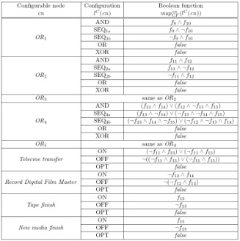
Application of the approach
Questionnaire model
Mapping
+
=
input to
answers
Configured Model
Interactive Questionnaire
Reference Process Model

Slide 19
Overview of Quaestion

Slide 20



Design-time synthesis from scenarios
working
working
find body
find body
need medic
lifeless body
need medic
lifeless body
get medic
heart ma
get medic
check pulse
heart massage
medic avail
lifeless body
medic avail
lifeless body
A different approach
Small processes, named scenarios, are dynamically merged upon request
Thus, a large process is synthesized by composing several fragments
medic avail
lifeless body
adrenaline
patient awake
bring to
hospital
  D. Fahland, H. Woith, Towards Process Models for Disaster Response, Business Process Management Workshops 2008
working

Slide 21
Design-time synthestis from scenarios
S1
working
S3
working
find body
find body
need medic
lifeless body
need medic
lifeless body
get medic
heart massage
get medic
check pulse
medic avail
lifeless body
medic avail
lifeless body
S2
lifeless body
medic avail
lifeless body
medic avail
adrenaline
adrenaline
Places are associated with labels
Labels determine the points where scenarios can be concatenated
If needed, new scenarios can even be appended at run-time as a mechanism of adaptation
patient awake
patient awake
bring to
hospital
bring to
hospital
working
working

Slide 22
Adaptive Process Management
Affected Area
Picture store
Museum
Operator
Precarious
Bell-Tower Building
Photo-Camera
Church
Team Leader
Bridge
Notes:
In order to coordinate, the team members have to be connected continuously but this is not guaranteed in MANET. Let’s consider the situation of the photo-camera moving towards the Church in order to take a photo.
The movement to reach the destination could bring to Photo-Camera’s isolation.
In such cases the software should be able to predict such a situation and possibly choose a bridging device to follow the member going to disconnect, in order to keep network connected.

Slide 23
Adaptive Process Management
The handler to deal with the exception, the relevant exogenous event which would affect the successful termination of the process
Notes:
Disconnection Management causes process restructing: a need activity is put in parallel to the one carried out by disconnecting actor. Such an activity is assigned to the chosen bridging device.

Slide 24
Two ways for adapting…
Anticipating all possible discrepancies.
  Nowadays, APMSs use mostly this approach.
  Feasible and valuable in static contexts, where exceptions occur rarely.
  In very dynamic scenarios, too many exceptions need to be considered.
Using the metaphor of the try/catch construct:
try {
task1;
task2;
task3 || subProcess();
}
catch(Disconnection) { … }
catch(Devices Down) { … }
catch(Exception1) { … }
catch(Exception2) { … }
catch(Exception3) { … }
catch(Exception4) { … }
...
The list of all expected exceptions. What if any unexpected occurs?

Slide 25
Two ways for adapting…
Devising a general recovery method. This method should be able to handle any kind of event, even unexpected.
  The process is defined as if exogenous actions cannot occur (the try block).
  Whenever discrepancies are detected leading to no successful process termination, the control moves to the sole catch block.
    It activates a general recovery method
    It modifies the old process P in a process P0 terminable in the new environment and achieving all P’s goals
Using the metaphor of the try/catch construct:
try {
task1;
task2;
task3 || subProcess();
}
catch(Any Exception)
{
The generic method!
}
It analyses the changed environment and automatically adapts

Slide 26
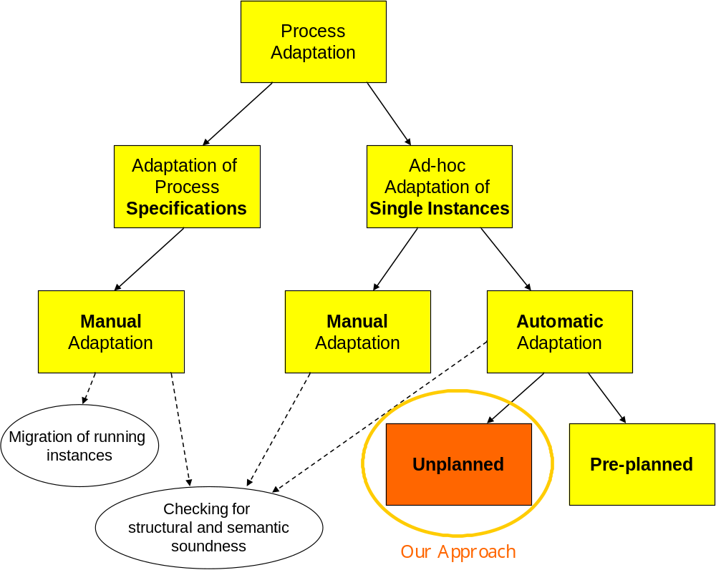
Related Work on Adaptiveness
Single instances are adapted to cope with changes in the environment where instances are executed
The process schema is adapted manually to changing policies, laws, practices, etc…
There exist some ECA-like rules that define how to handle specific events affecting instance terminations
Manual Adaptation approach envisions an expert who is charge of modifying the instances to handle these events
The issue is to change running instances to fit with changes of the schema
The schema of the running instances is automatically adapted to make terminate them in the new environment

Slide 27
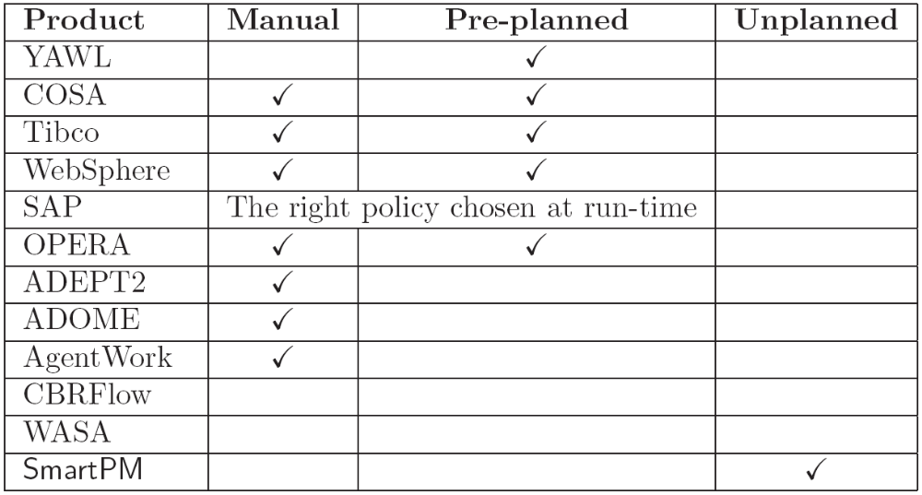
Comparison of Existing Approaches
WASA e CBRFlow do not allow
ad-hoc adaptation of single instances
PAGE 26
Policies defined at design-time.
It’s decided at run-time what policy to apply
There exists no Process Manager handling adaptation of unplanned exogenous events
PAGE 26

Slide 28
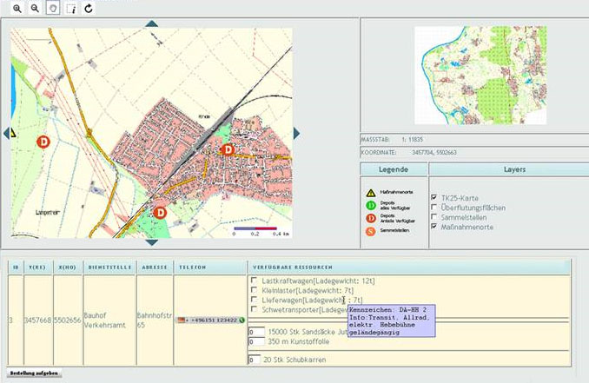
A case study: AristaFlow BPM Suite
  A. Lanz et al., Enabling Process Support for Advanced Applications with the AristaFlow BPM Suite, Business Process Management Demonstration Track 2010
  R. Pryss et al., Managing Processes on Mobile Devices: The MARPLE Approach. CAiSE'10 Demos, 2010

Slide 29
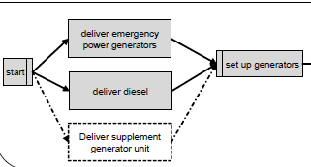
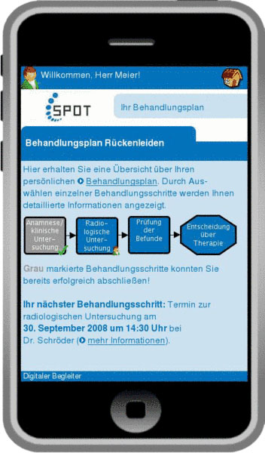
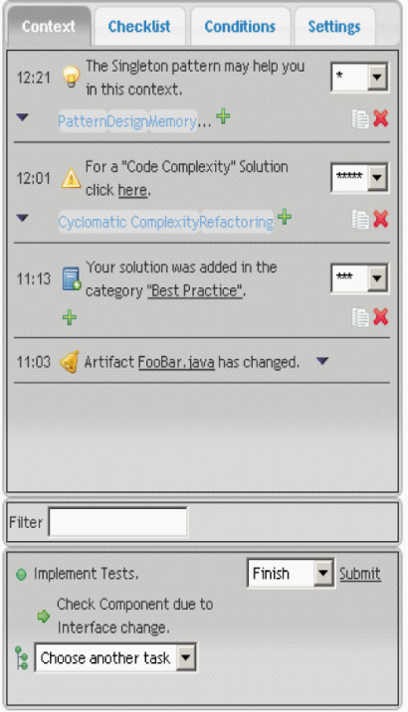
AristaFlow
It allows for verification of the process structure
It features an intuitive approach to adapt process instances at run-time to deal with contingencies
  Non-computer experts are also able to apply changes
  Adapted processes are checked for soundness
A mobile version is also available
  Tasks can be executed in disconnected mode
  The task outcomes are later synchronized with the PAIS server.
Drawbacks:
  Processes are manually adapted!
  The server cannot run on mobile devices.

Slide 30
Execution Monitoring
Techniques for monitor of discrepancies: “sensing” of the real world and aligning of the internal virtual reality.
  Possibly predicting misalignments before their actual occurrence.
Techniques for identification of corrective actions.
Techniques for automatic process restructuring.
1
Process P is NO MORE terminable successfully in the context C1
e
< P, C >
< P, C1 >
Process P is successfully terminable in the context C
Adaptation
Process P1 is terminable in the context C1 AND P1 pursues all P’s goals
< P1, C1 >
2 and 3

Slide 31

Automatic Adaptation of Processes
Tool for
process design
Initial process
initial context
Task assignment
Input & Output
Data
Process Engine
Services
& Apps
Sensors are intended as any software and/or hardware component able to get contextual information from the external world.
Adapted Process
Alignment of mental
context with sensed
data
Execution
Monitor
Changes in process
and in
mental context
It’s the interface used by designers to define the process schema
For each execution step, it aligns the mental world in “PMS” mind with reality and data retrieved from external world by sensors, possibly adapting the process to unforeseen exogenous events
The APMS modules assigning tasks to actors, considering context and actors’ capability
Sensor
External World
  M. de Leoni et al, Highly Dynamic Adaptation in Process Management Systems Through Execution Monitoring, Proceedings of BPM 2007

Slide 32
The WORKPAD Project
The development of an Adaptive Peer-to-Peer Software Infrastructure for Supporting Collaborative Work of Human Operators in Emergency/Disaster Scenarios.
The tools’ development has been following an user-centered design methodology
  Guarantee the architecture and the resulting system has met the end-user requirements
  T. Catarci et al. Pervasive Software Environments for Supporting Disaster Responses, IEEE Internet Computing 12(1): 26-37 (2008)
  T. Catarci et al. The WORKPAD Project Experience: Improving the Disaster Response through Process Management and Geo Collaboration, In Proc. of the 7th International Conference on Information Systems for Crisis Response and Management (ISCRAM), 2010

Slide 33
The showcase/drill
The goodness of the WORKPAD outcomes to manage emergencies is proven by a showcase held in June, 2009.
  Simulation of an emergency and its management
  Comparing of the efficiency/effectiveness when dealing with an emergency with and without WORKPAD

Slide 34
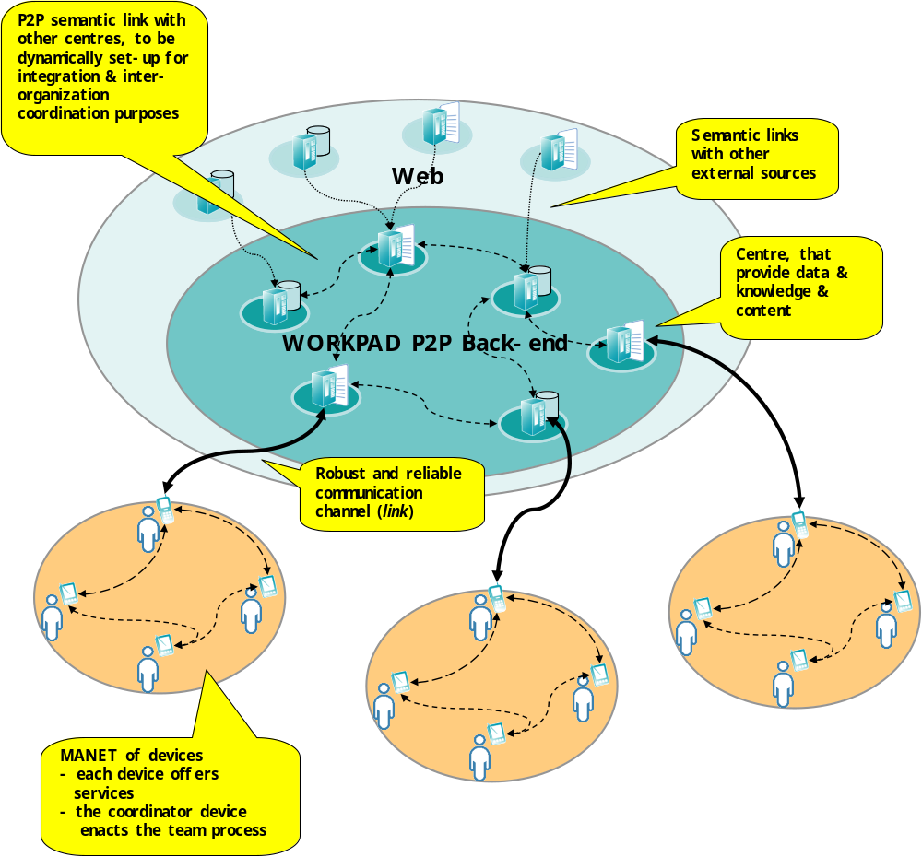

Slide 35
ROME4EU: Roman Orchestration Mobile Engine for Emergency Unit
ROME4EU is the PMS developed for WORKPAD
The engine running into the leader’s PDA
The operators host the client named Task Handler
When the engine finds tasks to assign, it connects to Task Handler of the given member
  Task Handlers are not generally used to execute tasks.
  Task Handlers are only meant to run the applications to execute tasks.
  M. de Leoni et al., Mobile Process Management through Web Services,
  Proc. of the 7th IEEE 2010 International Conference on Services Computing (SCC), 2010

Slide 36
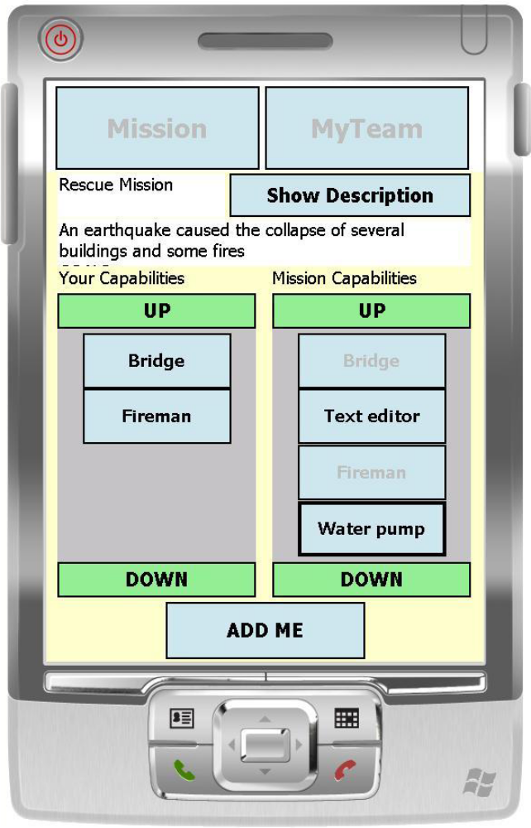
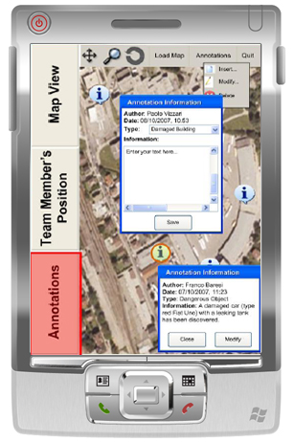
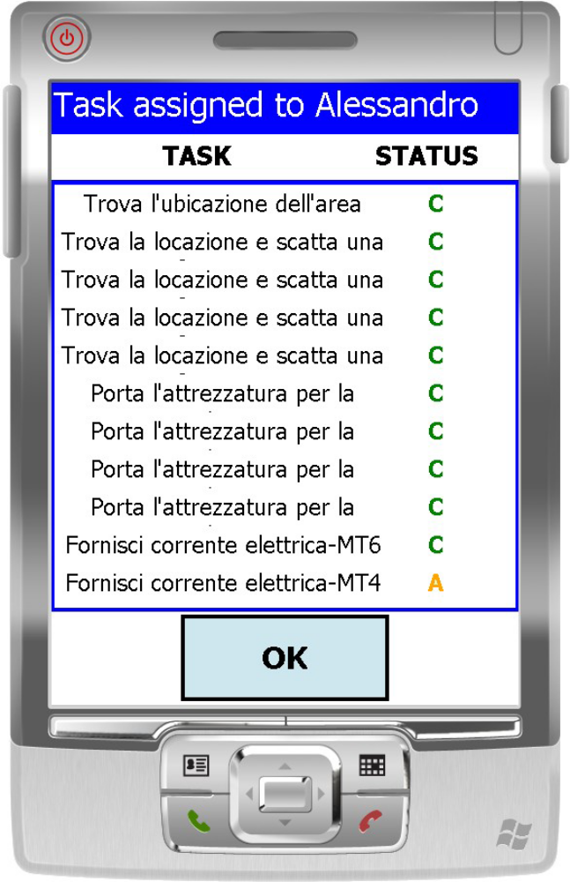
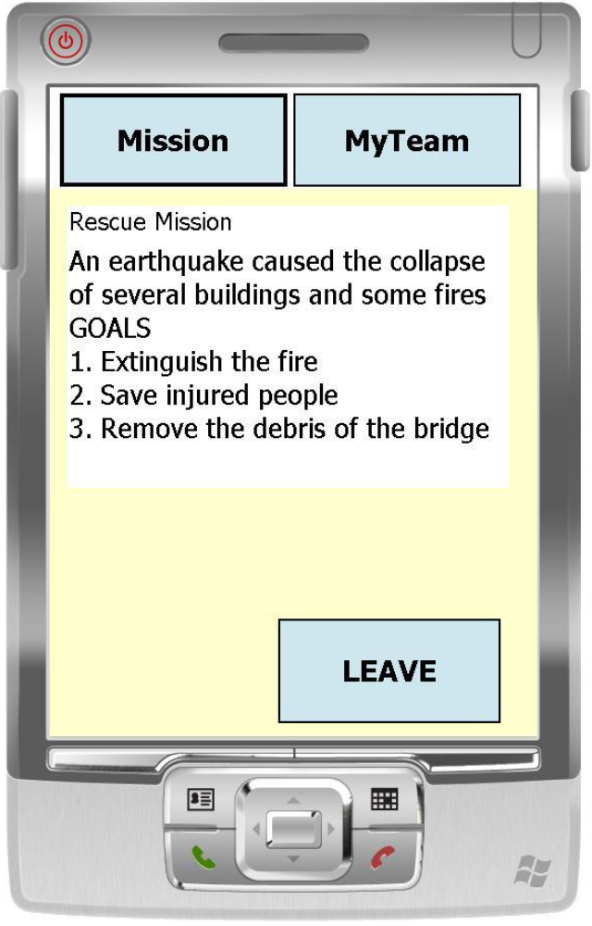
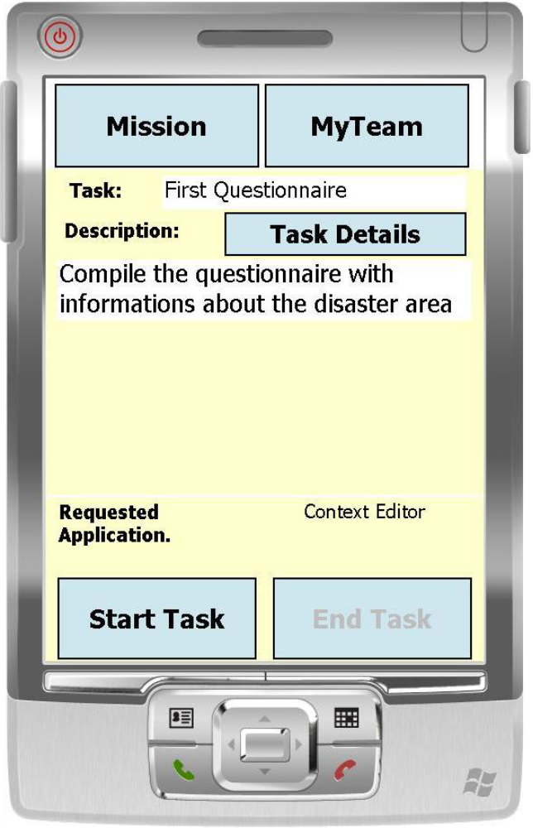
Some screenshots

Slide 37
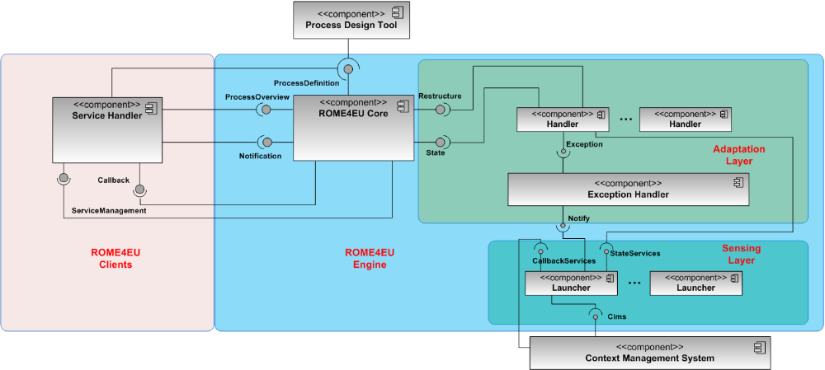
The ROME4EU Internal
Both automatic services (e.g. web services) and human GUI-based tools are abstract out as BPEL-compliant services.
The communication between the ROME4EU engine and the services happen on top of a web-service middleware running on PDAs
Process schemas are given as WS-BPEL specifications
Layer to manage and mitigate consequences
Layer to sense occurring contingencies
ROME4EU is based on our own implementation of a WS-BPEL engine running on PDA

Slide 38
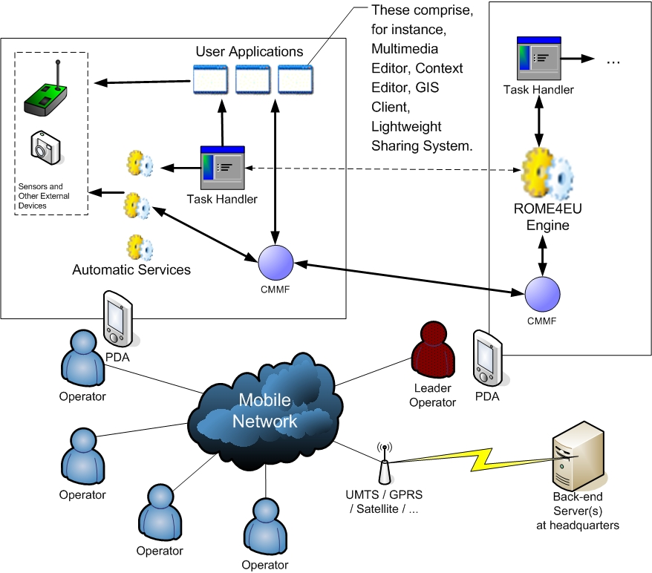
A zoom into front-end
Front-end users break down into:
  Leaders hosting the ROME4EU server
    Exactly one leader per team
  Generic Operators acting as client receiving activities to carry on from respective leaders

Slide 39
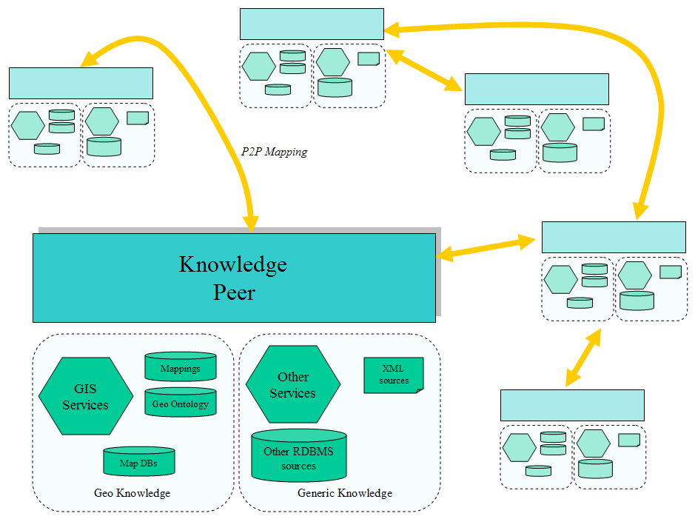
A zoom into the back-end
The WORKPAD’s Back-End network is a Peer-to-Peer Semantic Data Integration System (P2P-DIS)
Each Peer is a Semantic Data Integration System wich
  Has an own ontology as global schema
  Integrates heterogeneous sources through mapping with the local ontology
  Integrates other peers through mappings between ontologies
A Client is able to
  Perform semantic conjunctive queries
  Receive notifications about relevant data changes (Add and Remove subscriptions)

Slide 40
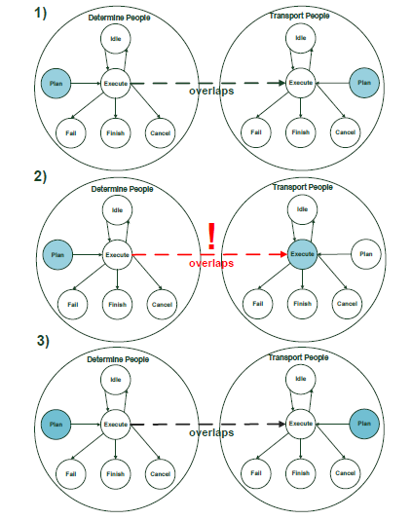
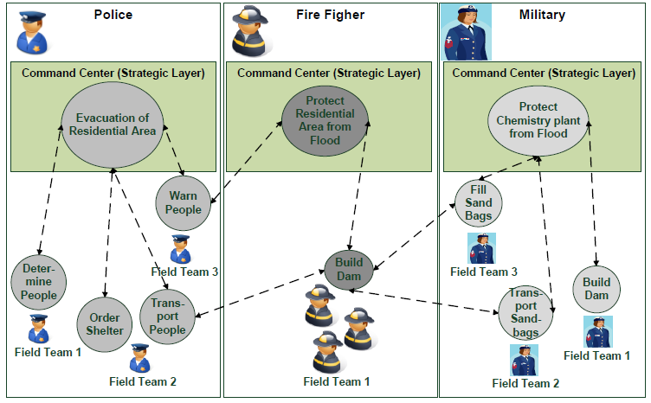
WORKPAD does not deal with no coordination of diverse response units
Synchronization of activities of different processes executed by different team units
Activities can be in different states
Providing synchronization between the statuses of pairs of activities.
  J. Franke et al. A Model for Temporal Coordination of Disaster Response Activities, 7th International Conference on Information Systems for Crisis Response and Management (ISCRAM), 2010.

Slide 41
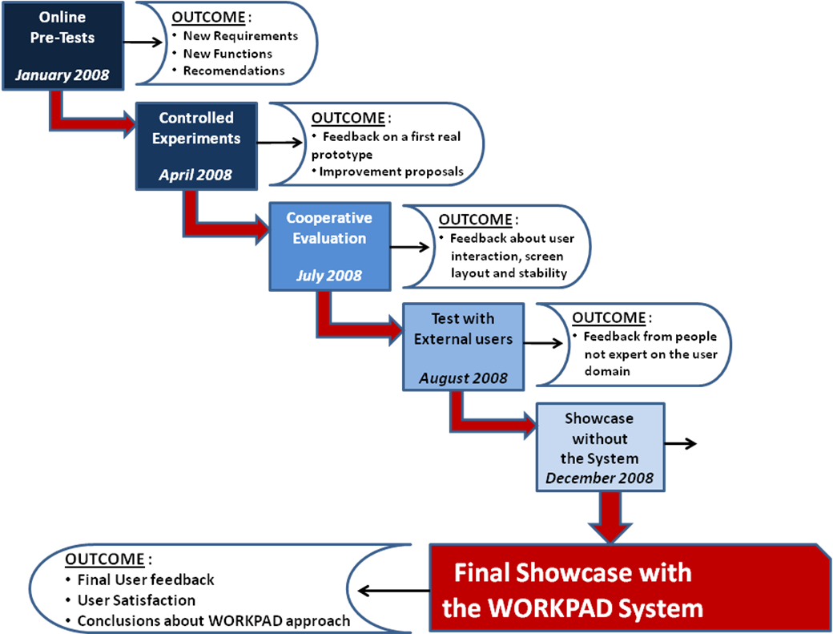
User-centered Design

Slide 42
First Showcase without WORKPAD
In the scope of the 100th anniversary of the Messina earthquake event of PCRC
Intention of the WORKPAD team:
  Better understanding of real world activities
  Verifying if storyboards are feasible and realistic
  Become familiar with the showcase site Pentidattilo
  Practical issues (logistics, power, toilets etc)

Slide 43
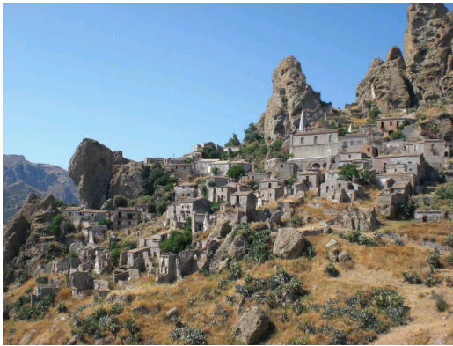
Showcase with WORKPAD
Goal:
  Show and evaluate the prototypical implementation of the reference architecture proposed in the project WORKPAD
Six end-user organisations
Four storyboards

Slide 44
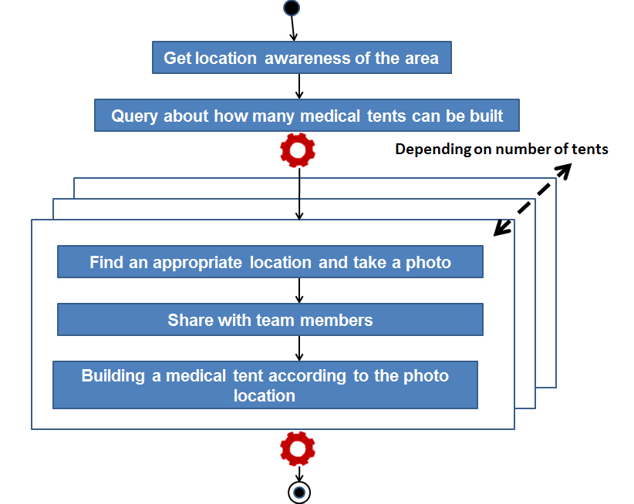
A storyboard: “Establishing a medical point”

Slide 45
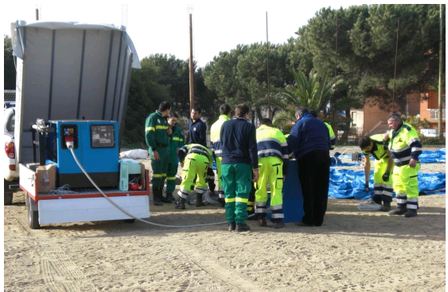
Some Impressions…

Slide 46
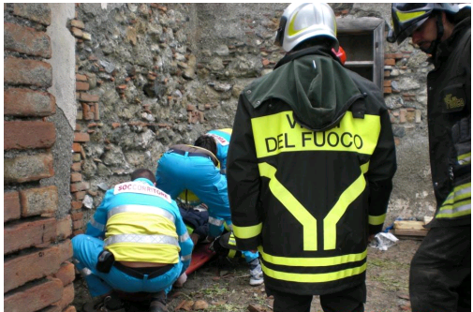
Some Impressions…

Slide 47
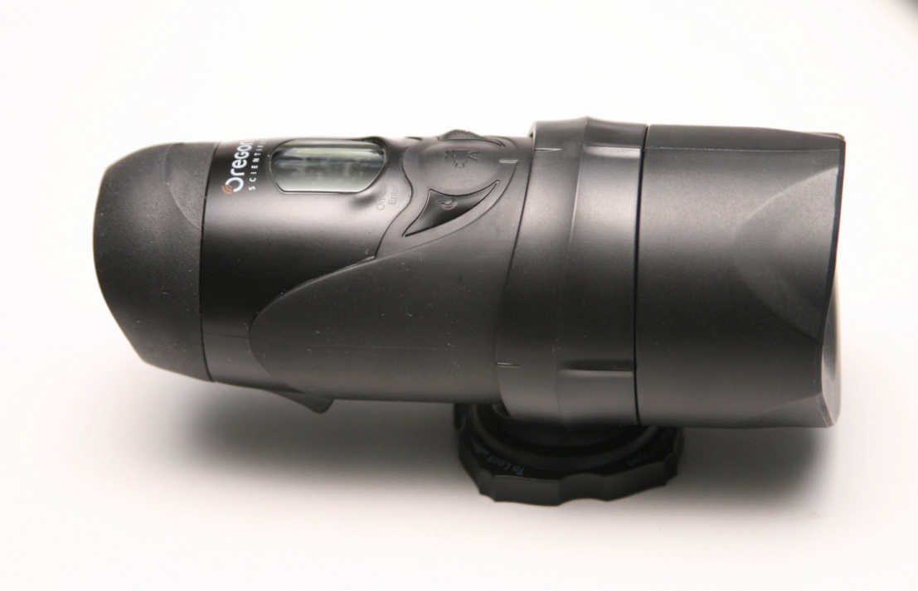
Documentation
Task execution forms
Interview questionnaires
Video recording, e.g.: Oregon Action Cam

Slide 48
Selected Analysis Results
Evaluation is based on task execution forms and interviews
Trial and “real” execution
  Comparing the effectiveness factors after the 1st (after training the users) and 2nd (real demo) usage of WORKPAD
  For interesting conclusions: all mean values dropped meaning that users get used to the WORKPAD system quickly

Slide 49
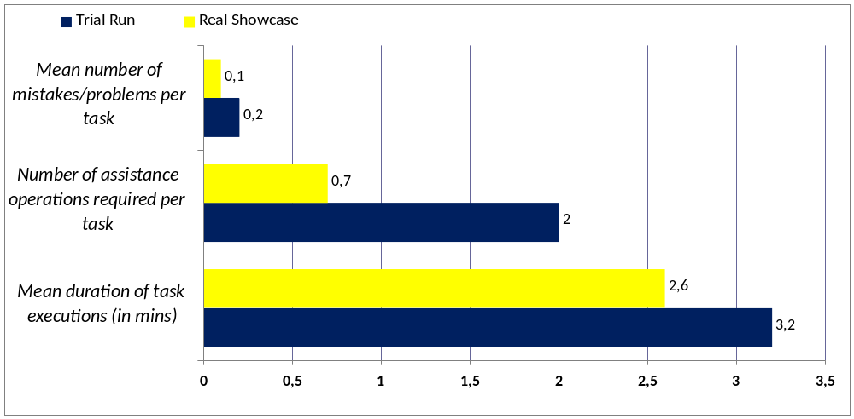
Results / 1
Good usability: end users can easily learn how to use the system
(even expert users would tend to forget every system since not used on daily basis

Slide 50
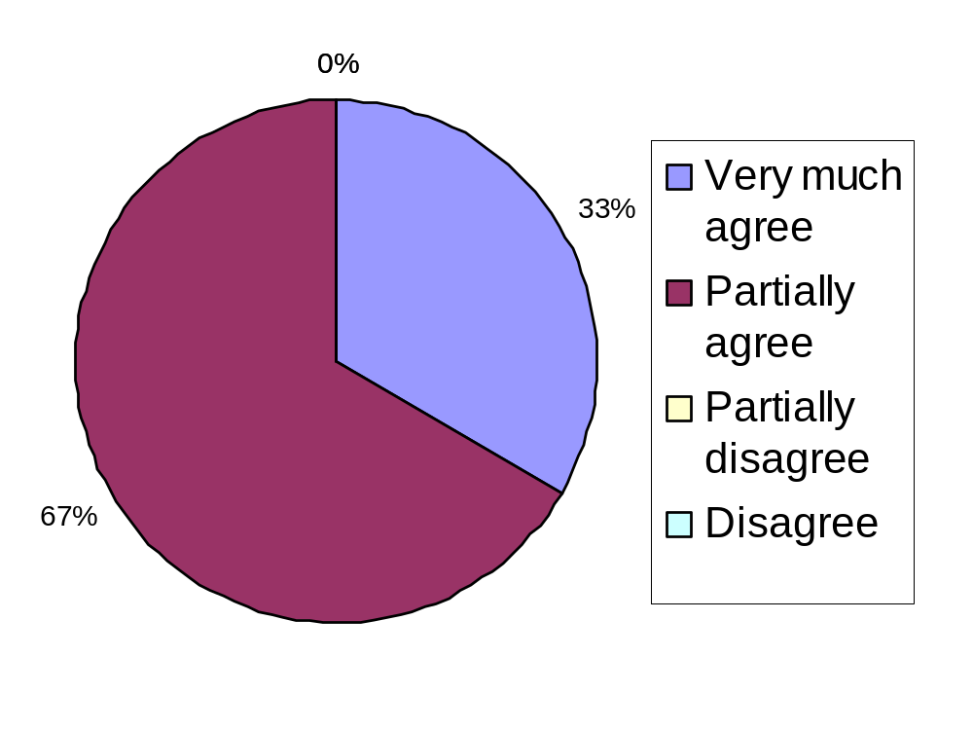
Results / 1
The WORKPAD system is easy and intuitive to use?

Slide 51
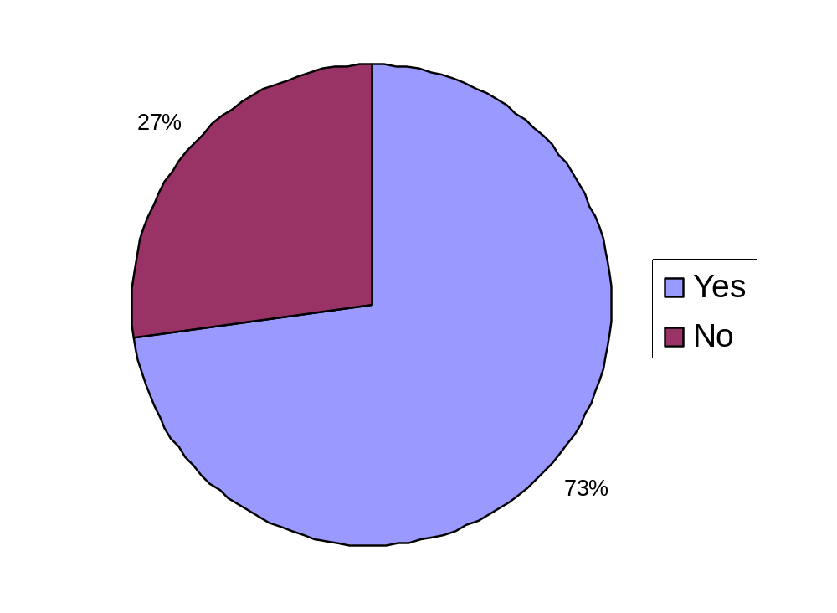
Results / 2
Does the WORKPAD system improve emergency management?

Slide 52
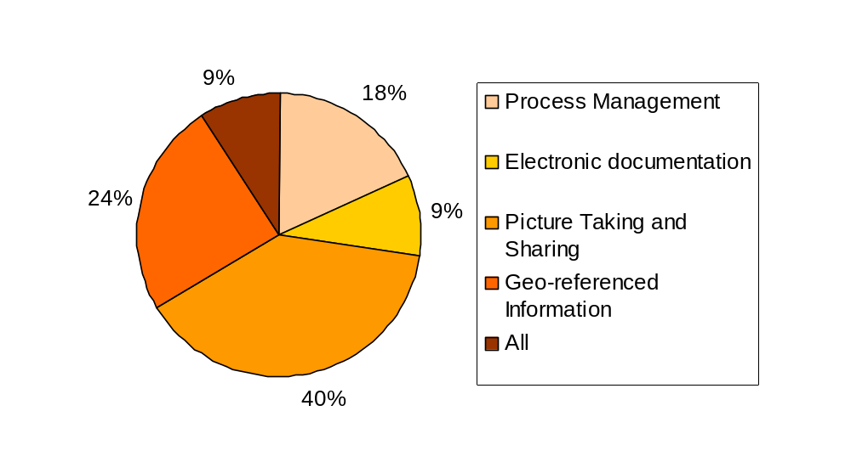
Results / 3
Which aspects do you consider as very useful?

Slide 53
Lesson learned / 1
PAISs useful during emergency management to improve the effectiveness
  The process metaphor well understood by end users.
PAISs forced civil protection depts. to systemize the procedures to manage emergencies
  Hidden inefficiencies found and partially solved.
  Finally, the improvement of the response time was also due to such a process reengineering.

Slide 54
Lesson learned / 2
PDAs need to be use on the spot under the direct sunbeams and in extreme conditions
  Highly-contrasting colors are important (e.g., white on black, yellow on blue).
  Users might not have free hands to use PDA’s stylus: buttons should be sized for being touchable by hands
Geo-referenced Information Systems necessary to become aware of the current situation.
Data integration of systems of diverse headquarters cannot rely on a hierarchical infrastructure and a global ontology
  Different local ontologies should be integrated and mapped each other

